Slide 1
Azure Kubernetes Hackfest
Delivering modern cloud native applications with open source technologies on Azure

Slide 2
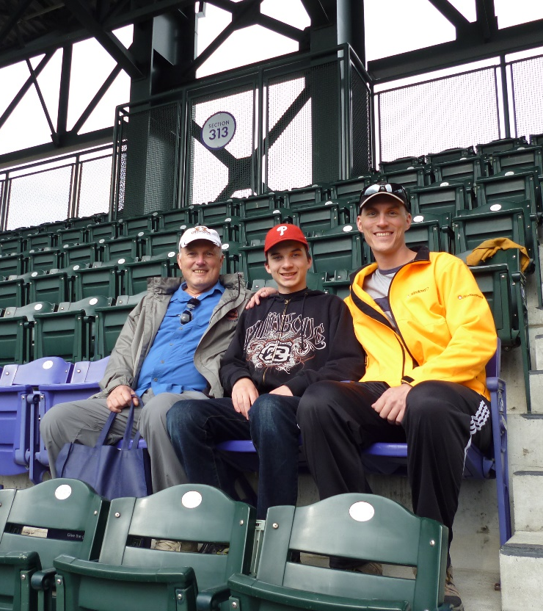
Kevin Harris
Open Source Solutions Lead
Azure Global Black Belt
Microsoft Canada
Kevin.Harris@Microsoft.com
@KevBHar

Slide 3

Ray Kao
Open Source Solutions Lead
Azure Global Black Belt
Microsoft Canada
Ray.Kao@Microsoft.com
@RayKao

Slide 4

Mathieu Benoit
Cloud Solution Architect
Microsoft Canada
Mathieu.Benoit@Microsoft.com
https://aka.ms/mabenoit

Slide 5
Agenda
Time
Topic
8:30 – 9:00
Breakfast and Getting Settled
9:00 – 10:00
Cloud Native Applications, Containers, and Docker
10:00 – 11:15
HANDS-ON: Labs 1, 2
11:15 – 12:00
Kubernetes Overview, Azure Kubernetes Service
12:00
Lunch
1:00 – 2:00
HANDS-ON: Labs 3, 4, 5
2:00 – 2:45
Kubernetes Concepts, ACI, ACR, Operations / Management Concepts, Scaling
2:45 – 3:15
HANDS-ON: Labs 6, 7
3:15 – 3:30
Managing Storage and State, Online Service Broker, Upgrading
3:30 - 4:30
HANDS-ON: Labs 8, 9, 10
4:30 – 5:00
Release Tools, Q&A, Wrap-Up

Slide 6
Why Modernize Apps?

Slide 7
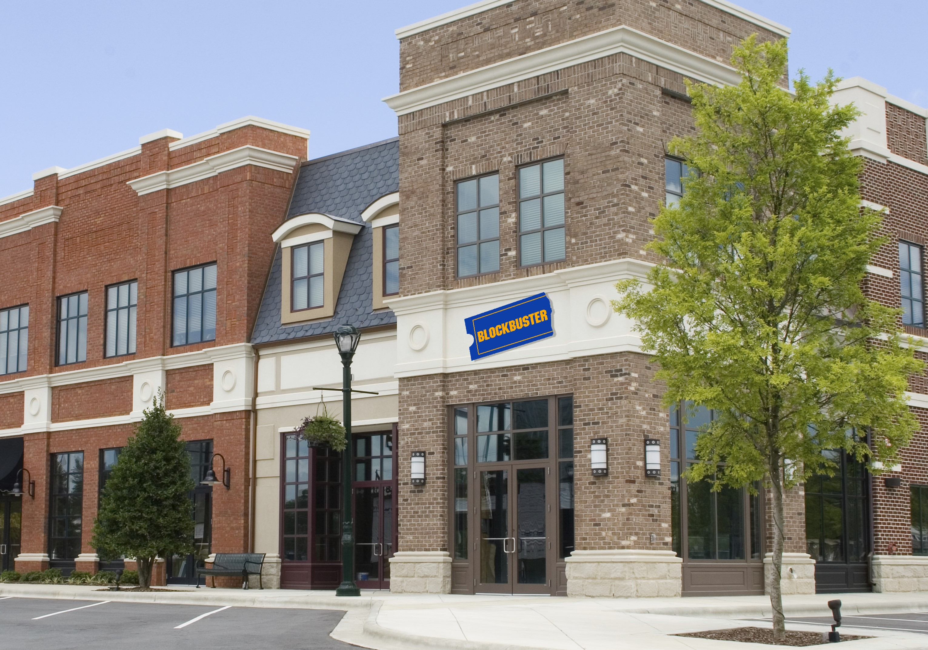








Slide 8

















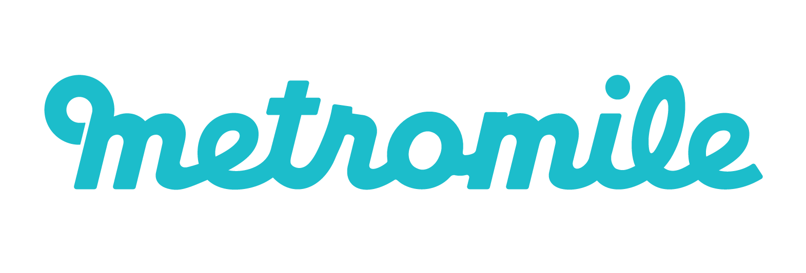







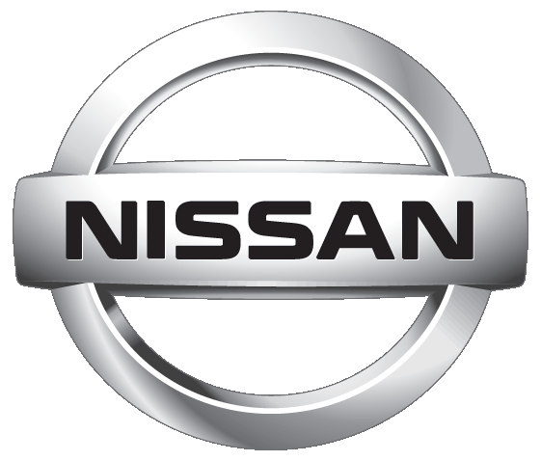




Digital is disrupting industry fundamentals
Products and technologies
Customer expectations
Business models
Smart ecosystems
Connected cars
New experiences
Car sharing services
Smart homes
Autonomous cars
Pay-as-you-go insurance
Smart infrastructure
Sales and service relationships
Electric vehicles
Fleet management services
Smart cities

Slide 9
Why should customers care about containers and microservices?

Slide 10
In reality, they shouldn’t…

Slide 11
They do care about cloud native applications
“Unlimited” Scale
Global reach
Rapid innovation -> time to market
Notes:
IE – We don’t build cloud native, distributed apps just because it is “cool” and new. The business benefits are key

Slide 12
From traditional app to modern app
APP
Existing Application
Modern Infrastructure
rehost as VMs or refresh to modern container platform.
Containerize Applications
Re-architect apps for scale with containers.
Modern Microservices
Add new services or start peeling off services from monolithic code.
On-Premises
Infrastructure Platform
IaaS
Infrastructure Platform
“lift & shift”
Containers
Container Platform
PaaS
Application Platform
Serverless

Slide 13
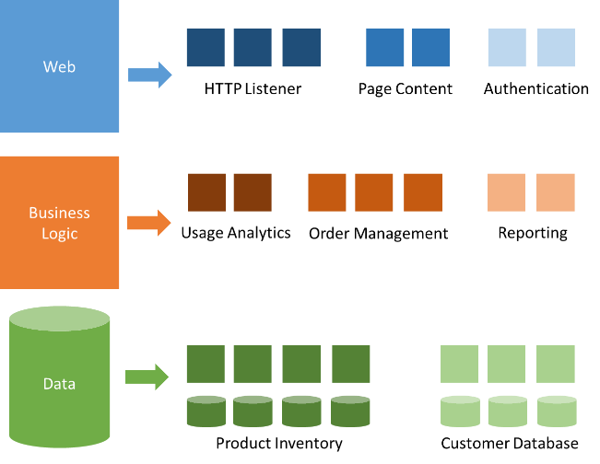
Modernization with microservices
Individually built and deployed
Small, independent services
Integrate using published API
Fine-grained, loosely coupled

Slide 14
Microservices Benefits
Independent deployments
Enables continuous delivery
No downtime upgrades
Improved scale and resource utilization per service
Fault isolation
Security isolation
Services can be distributed across multiple servers or environments
Multiple languages / diversity
Smaller, focused teams
Code can be organized around business capabilities
Autonomous developer teams

Slide 15
Microservices – The Hard Part
Deployment is complex
Testing is difficult
Debugging is difficult
Monitoring/Logging is difficult
New service versions must support old/new API contracts
Distributed databases make transactions hard
Cluster and orchestration tools overhead
Distributed services adds more network communication
Increased network hops
Requires failure/recovery code
Need service discovery solution
Advanced DevOps capability: short-term pain for long-term gain

Slide 16
http://12factor.net
http://12factor.net

Slide 17
12-Factor Apps (1-5)
Single root repo; don’t share code with another app
Deploy dependent libs with app
No config in code; read from environment vars
Handle unresponsive app dependencies robustly
Strictly separate build, release, & run steps
Build: Builds a version of the code repo & gathers dependencies
Release: Combines build with config ReleaseId (immutable)
Run: Runs app in execution environment
Notes:
Single root repo; don’t share code with another app
Deploy dependent libs with app
No config in code; read from environment vars
Handle unresponsive app dependencies robustly
Strictly separate build, release, & run steps
Build: Builds a version of the code repo & gathers dependencies
Release: Combines build with config → ReleaseId (immutable)
Run: Runs app in execution environment

Slide 18
12-Factor Apps (6-12)
App executes as 1+ stateless process & shares nothing
App listens on ports; avoid using (web) host
Use processes for isolation; multiple for concurrency
Processes can crash/be killed quickly & start fast
Keep dev, staging, & prod environments similar
Log to stdout (dev=console; prod=file & archived)
Deploy & run admin tasks (scripts) as processes
Notes:
App executes as 1+ stateless process & shares nothing
App listens on ports; avoid using (web) host
Use processes for isolation; multiple for concurrency
Processes can crash/be killed quickly & start fast
Keep dev, staging, & prod environments similar
Log to stdout (dev=console; prod=file & archived)
Deploy & run admin tasks (scripts) as processes

Slide 19
Microservices, Containers & Serverless
“Microservices is an architectural design point; containers & serverless are implementation details that often helps.”

Slide 20
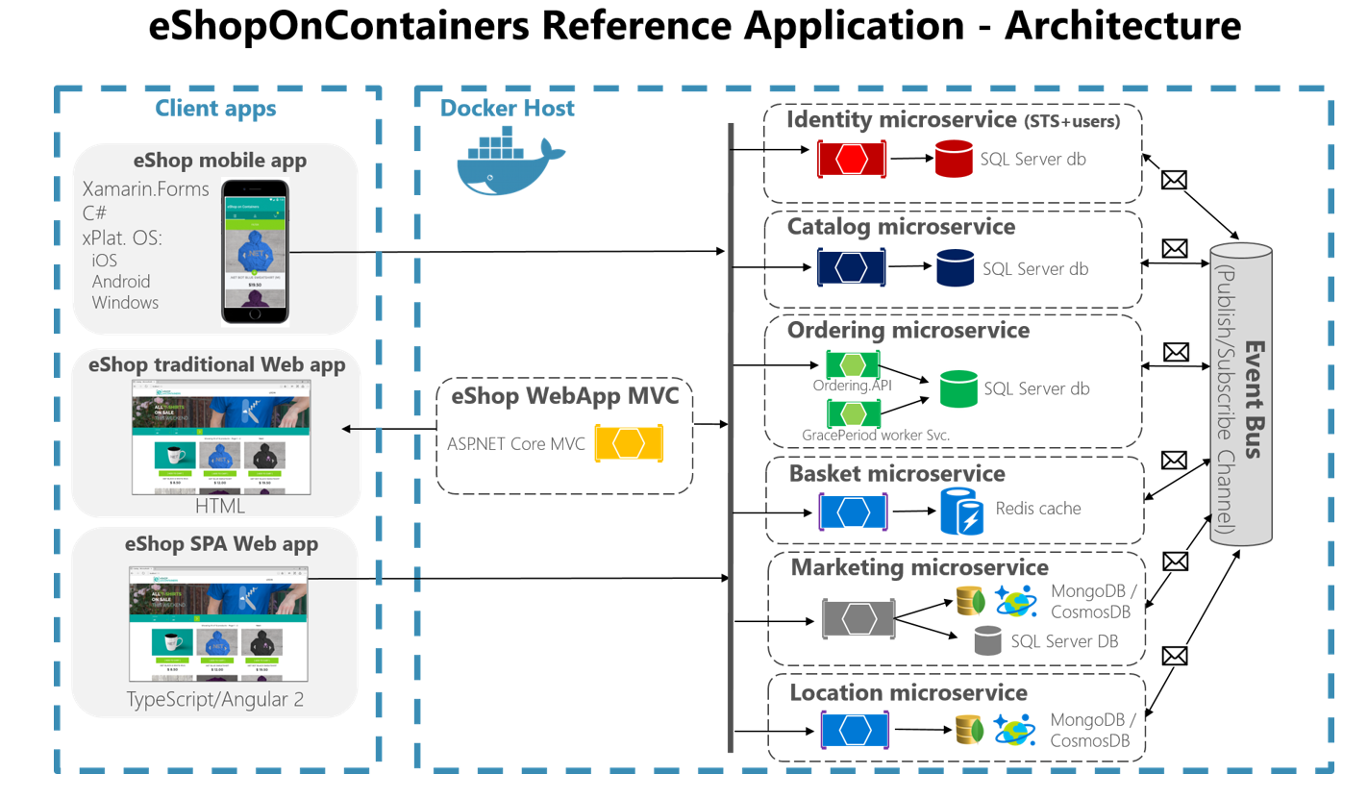
eShopOnContainers Reference App

Slide 21



Table of Contents
Azure Container Registry
Open source community
Azure Kubernetes Service (AKS)
Release automation tools
Containers 101
Getting started
Azure container technology
Open Service Broker for Azure (OSBA)
Customer success stories
Container orchestration
Azure Container Instances (ACI)

Slide 22
Containers 101
Azure Container Registry
Open source community
Azure Kubernetes Service (AKS)
Release automation tools
Containers 101
Getting started
Azure container technology
Open Service Broker for Azure (OSBA)
Customer success stories
Container orchestration
Azure Container Instances (ACI)

Slide 23
What we hear from developers
I need to create applications at a competitive rate without worrying about IT
New applications run smoothly on my machine but malfunction on traditional IT servers
My productivity and application innovation become suspended when I have to wait on IT

Slide 24
What we hear from IT
I need to manage servers and maintain compliance with little disruption
I’m unsure of how to integrate unfamiliar applications, and I require help from developers
I’m unable to focus on both server protection and application compliance

Slide 25
What is a container?
Containers = operating system virtualization
Traditional virtual machines = hardware virtualization
OS
Application
VM
VM
VM
Applications
Container
Container
Container
App
App
App
Kernel
OS
OS
OS
OS
Hardware
Hardware
Windows Server containers: maximum speed and density
Hyper-V containers: isolation plus performance
Container
Container
Container
Container
Container
Container
Kernel
Kernel
Kernel
Hardware
Hyper-V

Slide 26
Virtualization versus containerization
Virtual machine
Container
Application XYZ
Application
App dependencies
Dependencies
Guest OS
C
C
C
C
C
VM
VM
VM
VM
VM
VM
Dependency 1
Dependency 2
Hypervisor 2
Docker Engine
Hypervisor 1
Host OS
Host OS
Hardware
Hardware
Hardware
Type 1
Type 2
Virtualization
Containerization

Slide 27
The container advantage
Traditional virtualized environment
VM
VM
Low utilization of container resources
Application
Con.
Con.
Application
Containerization of applications and their dependencies
Con.
Con.
Hypervisor 2
Host OS
Hardware

Slide 28
The container advantage
Containerized environment
Migrate containers and their dependencies to underutilized VMs for improved density and isolation
VM
VM
Con.
Con.
Decommission unused resources for efficiency gains and cost savings
Con.
Con.
Docker Engine
Host OS
Hardware

Slide 29
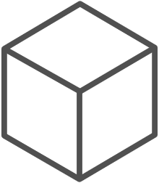
The container advantage
Fast iteration
Agile delivery
Immutability
Cost savings
Efficient deployment
Elastic bursting
For developers
For IT

Slide 30


Containers are gaining momentum
Does your organization currently use container technologies?¹
23%
My org. is evaluating container technologies
Yes, my org. currently uses container technologies
No, my org. is not using container technologies
Not sure
Not applicable
Larger companies are leading adoption.²
42%
~60%
25%
7%
Nearly 60% percent of organizations running 500 or more hosts are classiﬁed as container dabblers or adopters.
2%
The average company QUINTUPLES its container usage within 9 months.¹
Container hosts often run SEVEN containers at a time.¹
Containers churn 9 times FASTER than VMs.¹
5x
7x
9x
Source:
1: Datadog: 8 Surprising Facts About Real Docker Adoption; 2: DZone: The DZone Guide to Deploying and Orchestrating Containers

Slide 31


Industry analysts agree
“By 2020, more than 50% of enterprises will run mission-critical, containerized cloud-native applications in production, up from less than 5% today.”

Slide 32
Docker, Docker, Docker
Containers have been around for many years
Linux kernel: cgroups, namespaces
Docker Inc. did not invent them
They created open source software to build and manage containers
Docker makes containers easy
Super easy. Fast learning curve
Docker is a container format and a set of tools
Docker CLI, Docker Engine, Docker Swarm, Docker Compose, Docker Machine

Slide 33
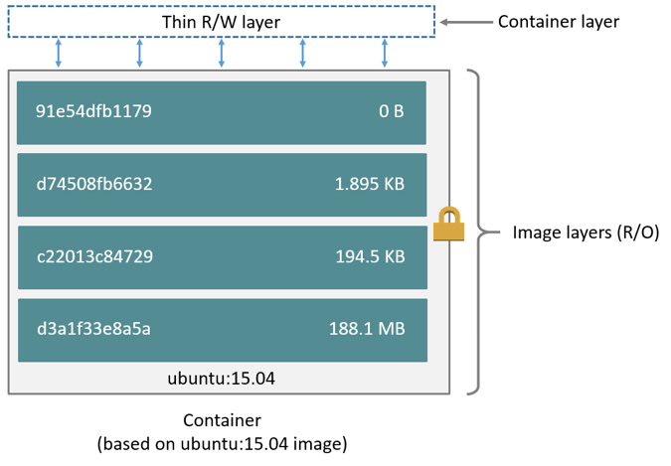
Docker Container Anatomy
Image source: https://docs.docker.com/engine/userguide/storagedriver/imagesandcontainers/#images-and-layers

Slide 34
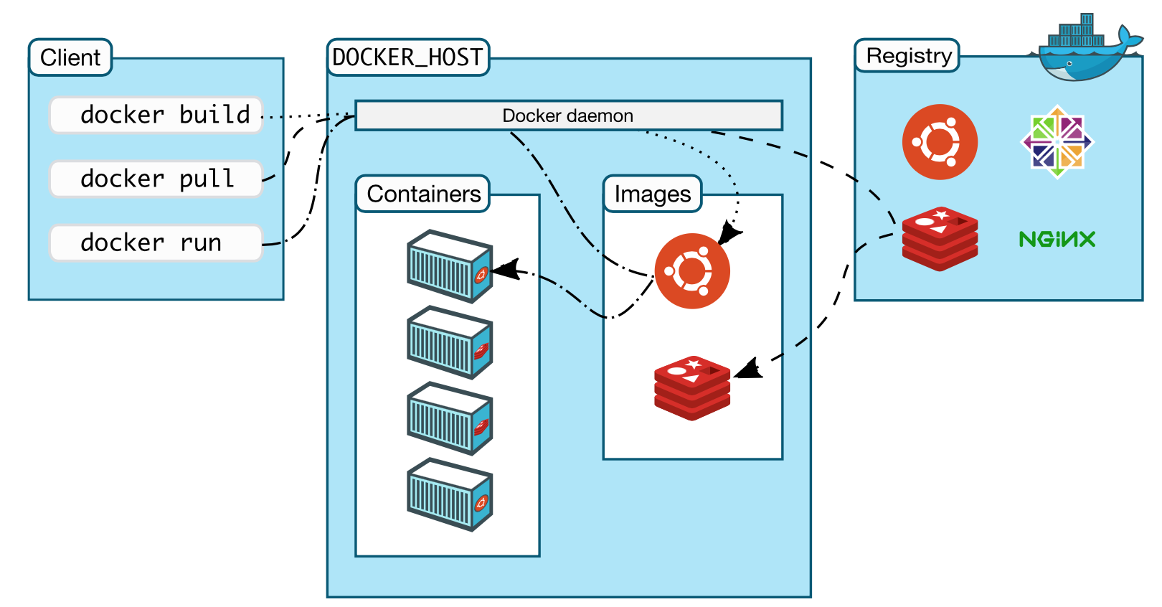
Docker Architecture

Slide 35
Demo
Dockerfile Anatomy
Container Creation (docker build)
Image Tagging (docker tag)
Working with Images (docker push & docker pull)

Slide 36
Labs: 1, 2 https://github.com/OSSCanada/aks_partnerworkshop

Slide 37
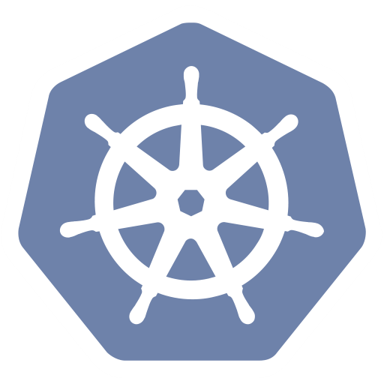
Container orchestration
Azure Container Registry
Open source community
Azure Kubernetes Service (AKS)
Release automation tools
Containers 101
Getting started
Azure container technology
Open Service Broker for Azure (OSBA)
Customer success stories
Container orchestration
Azure Container Instances (ACI)

Slide 38

“Distributed apps are sufficiently complicated that they need to be flown by the instruments”
Notes:
This is meant to highlight the need for advanced tooling and orchestration for highly complex distributed apps

Slide 39
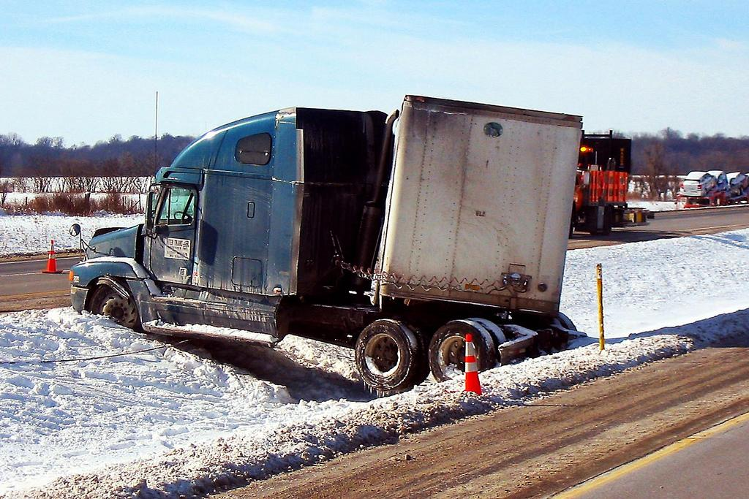


Slide 40
The elements of orchestration
Scheduling
Affinity/anti-affinity
Health monitoring
Failover
Scaling
Networking
Service discovery
Coordinated app upgrades

Slide 41
Kubernetes: the de-facto orchestrator
Portable
Public, private, hybrid, multi-cloud
Extensible
Modular, pluggable, hookable, composable
Self-healing
Auto-placement, auto-restart, auto-replication, auto-scaling

Slide 42
Kubernetes: empowering you to do more
Deploy your applications quickly and predictably
Scale your applications on the fly
Roll out new features seamlessly
Limit hardware usage to required resources only

Slide 43
Azure container technology
Azure Container Registry
Open source community
Azure Kubernetes Service (AKS)
Release automation tools
Containers 101
Getting started
Azure container technology
Open Service Broker for Azure (OSBA)
Customer success stories
Container orchestration
Azure Container Instances (ACI)

Slide 44
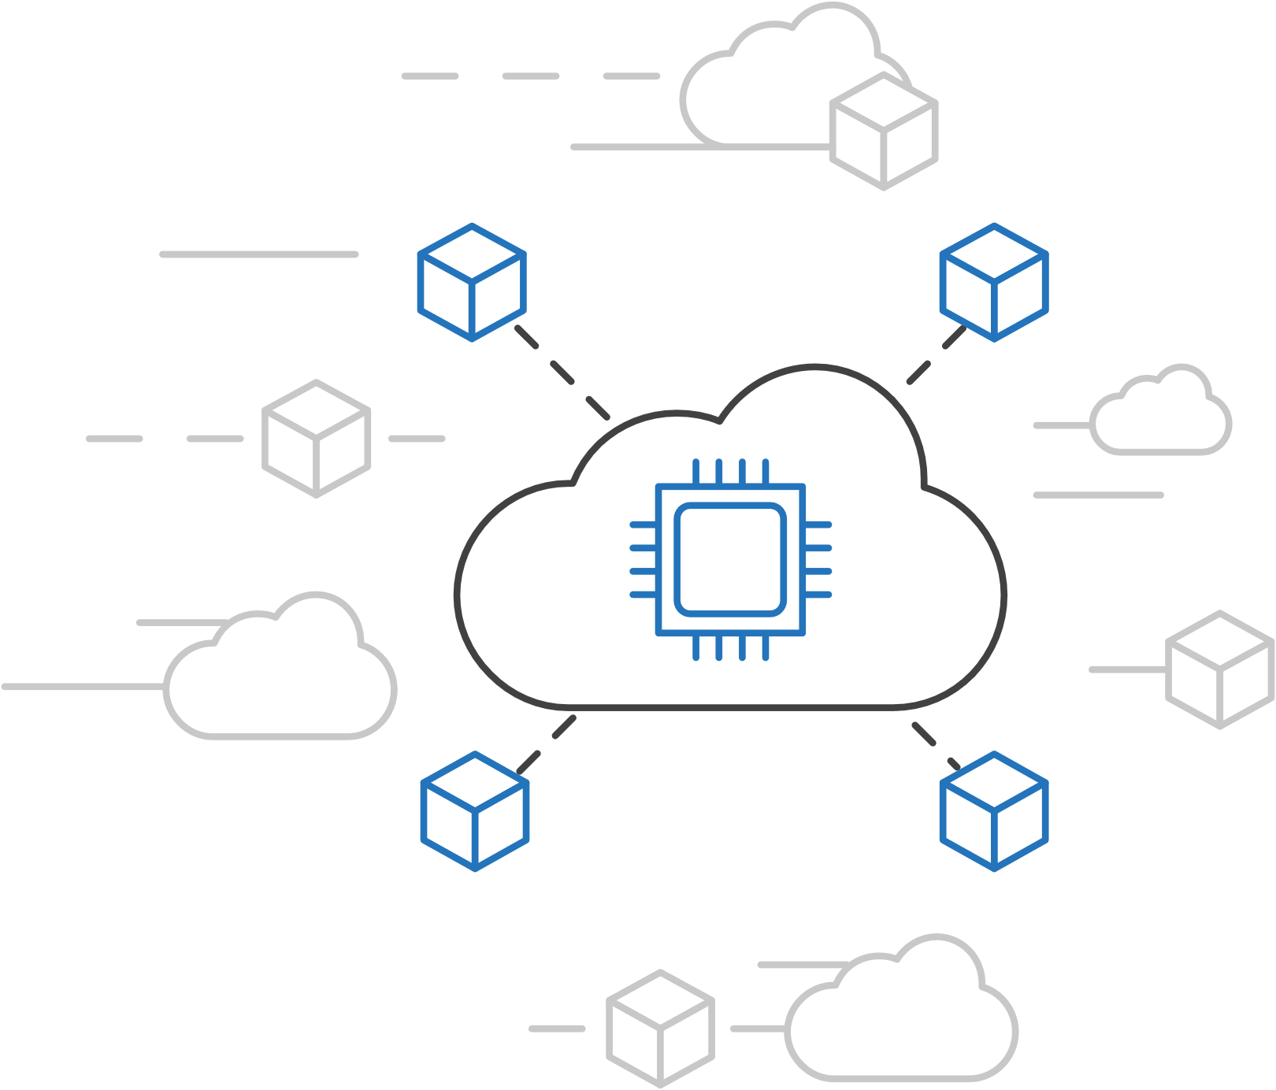
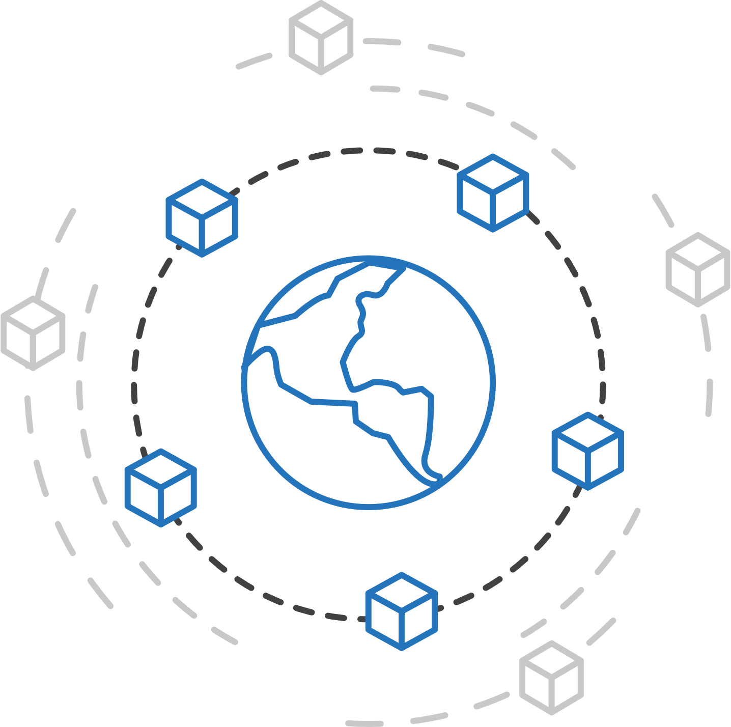
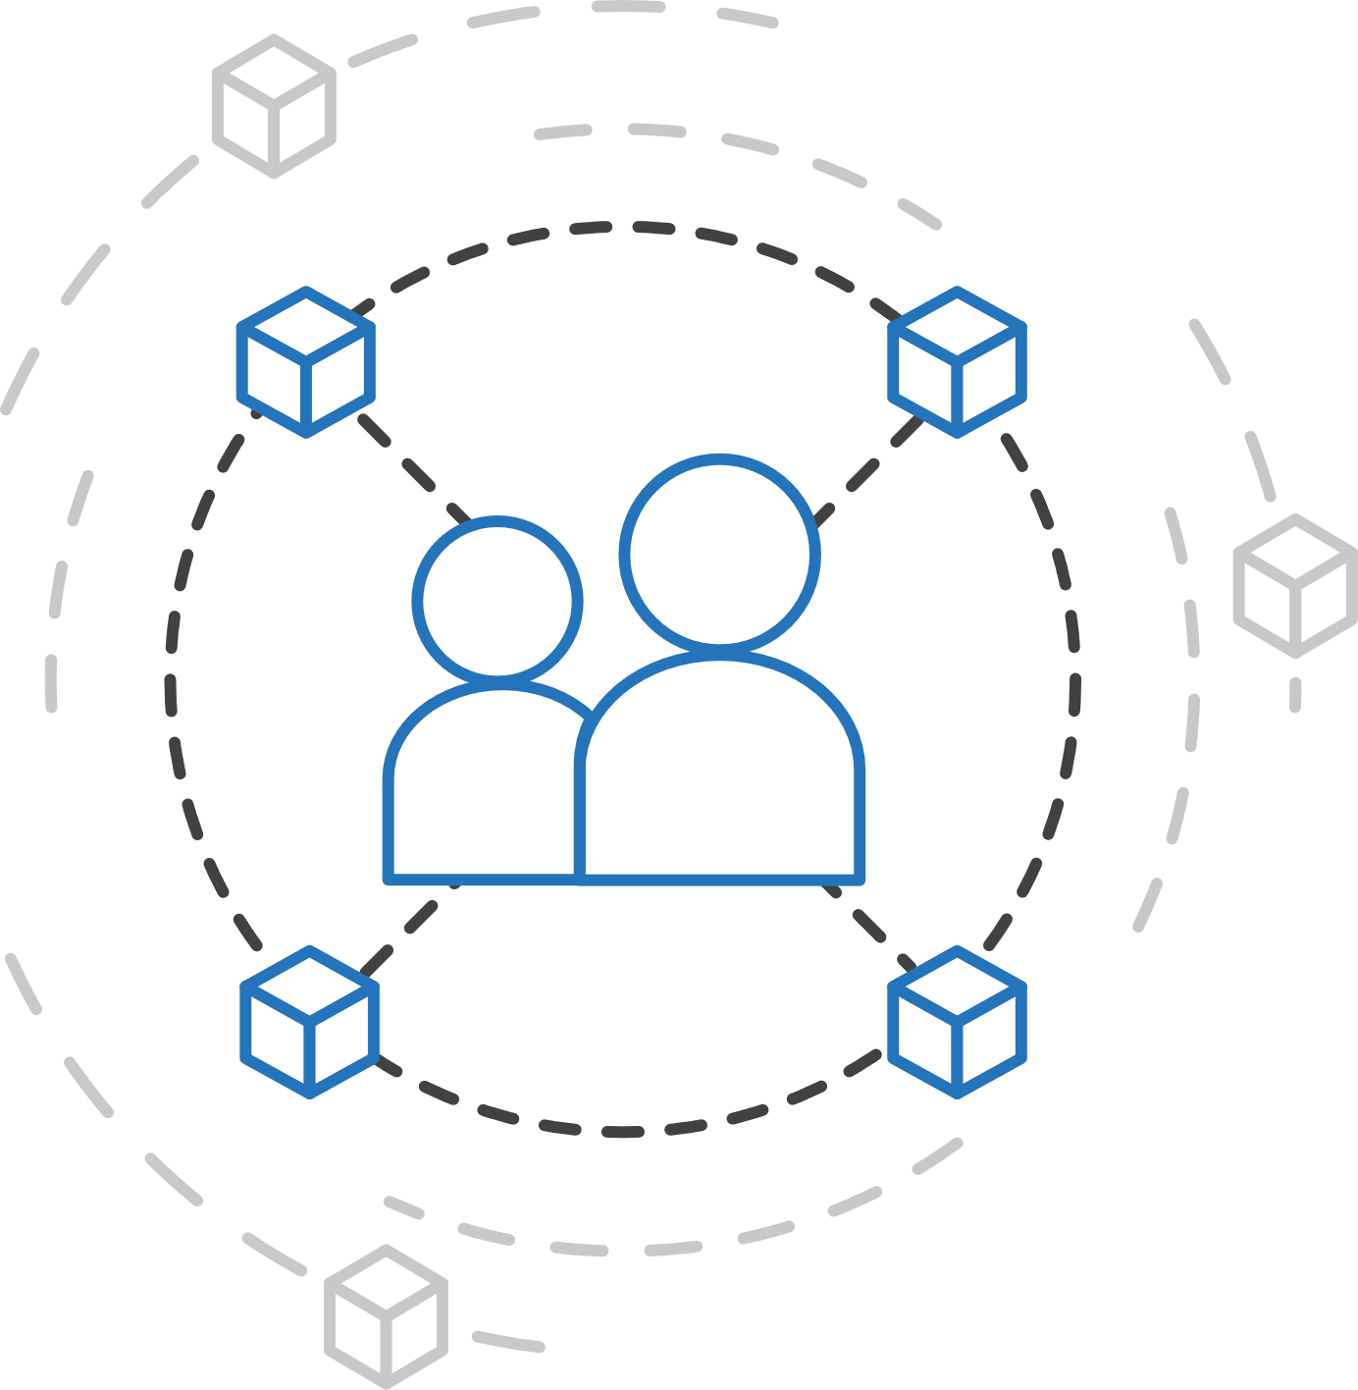
Azure container strategy
Embrace containers as ubiquitous
Support containers across the compute portfolio
Democratize container technology

Slide 45

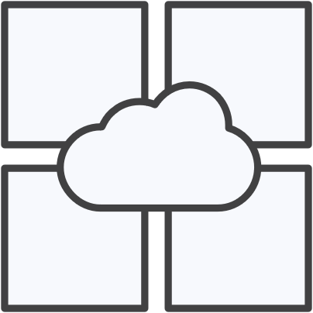

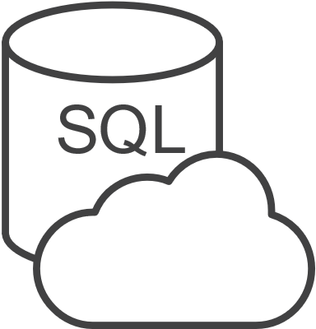

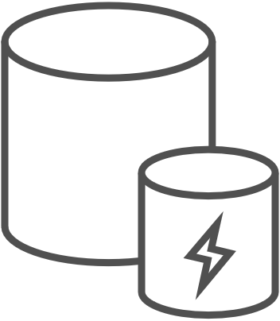

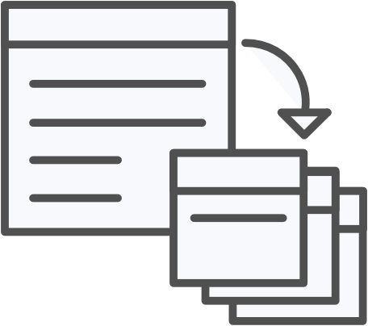


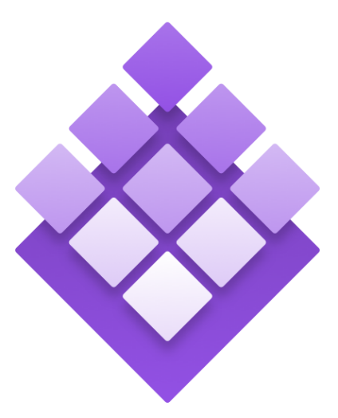
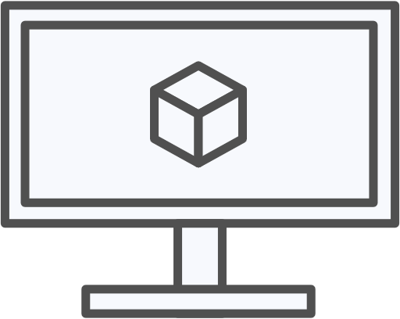
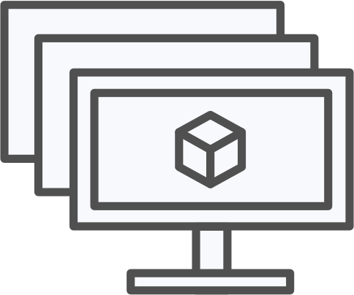
Azure container ecosystem
OSBA
App Service
Azure Container Registry (ACR)
Partner services
Azure services
PaaS
OpenShift
SQL Database
Azure Kubernetes Service (AKS)
Service Fabric
Batch
Pivotal Cloud Foundry
Redis Cache
ACS Engine
Docker Enterprise Edition
CosmosDB
Virtual kubelet
Mesosphere DC/OS
And more!
Azure Container Instances (ACI)
Azure Virtual Machines
Virtual Machine Scale Sets (VMSS)
Azure
IaaS

Slide 46
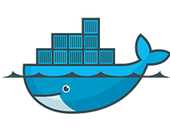



If you have a preferred container platform Pivotal Cloud Foundry  Kubernetes  Docker Enterprise Edition Red Hat OpenShift  Mesosphere DC/OS
Lets help you bring that platform to Azure

Slide 47
If you are without a preferred container platform…
Lets profile your needs and help you select the right option

Slide 48
Azure Kubernetes Service (AKS)
Azure Container Registry
Open source community
Azure Kubernetes Service (AKS)
Release automation tools
Containers 101
Getting started
Azure container technology
Open Service Broker for Azure (OSBA)
Customer success stories
Container orchestration
Azure Container Instances (ACI)

Slide 49

Azure Kubernetes Service (AKS)
Azure Kubernetes Service (AKS)
Azure Container Instances (ACI)
OSBA
App Service
Azure Container Registry (ACR)
Partner services
Azure services
PaaS
Azure Container Registry
OpenShift
SQL Database
Azure Kubernetes Service (AKS)
Service Fabric
Batch
Pivotal Cloud Foundry
Redis Cache
ACS Engine
Open Service Broker API (OSBA)
Docker Enterprise Edition
CosmosDB
Virtual kubelet
Mesosphere DC/OS
And more!
Azure Container Instances (ACI)
Azure Virtual Machines
Virtual Machine Scale Sets (VMSS)
Release Automation Tools
Azure
IaaS

Slide 50
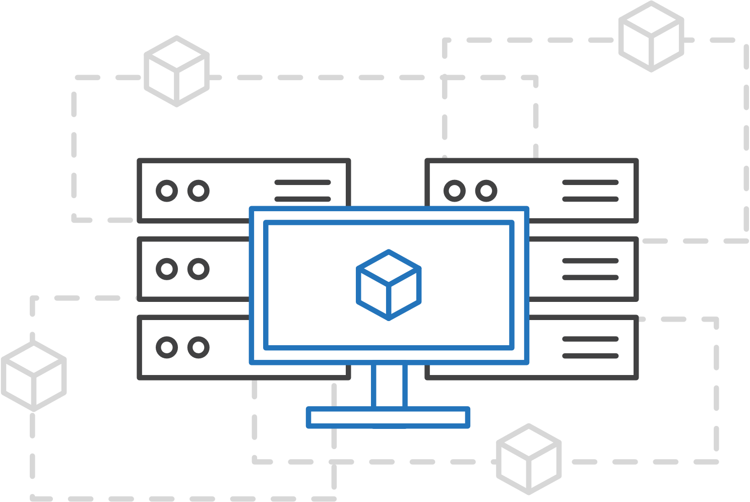
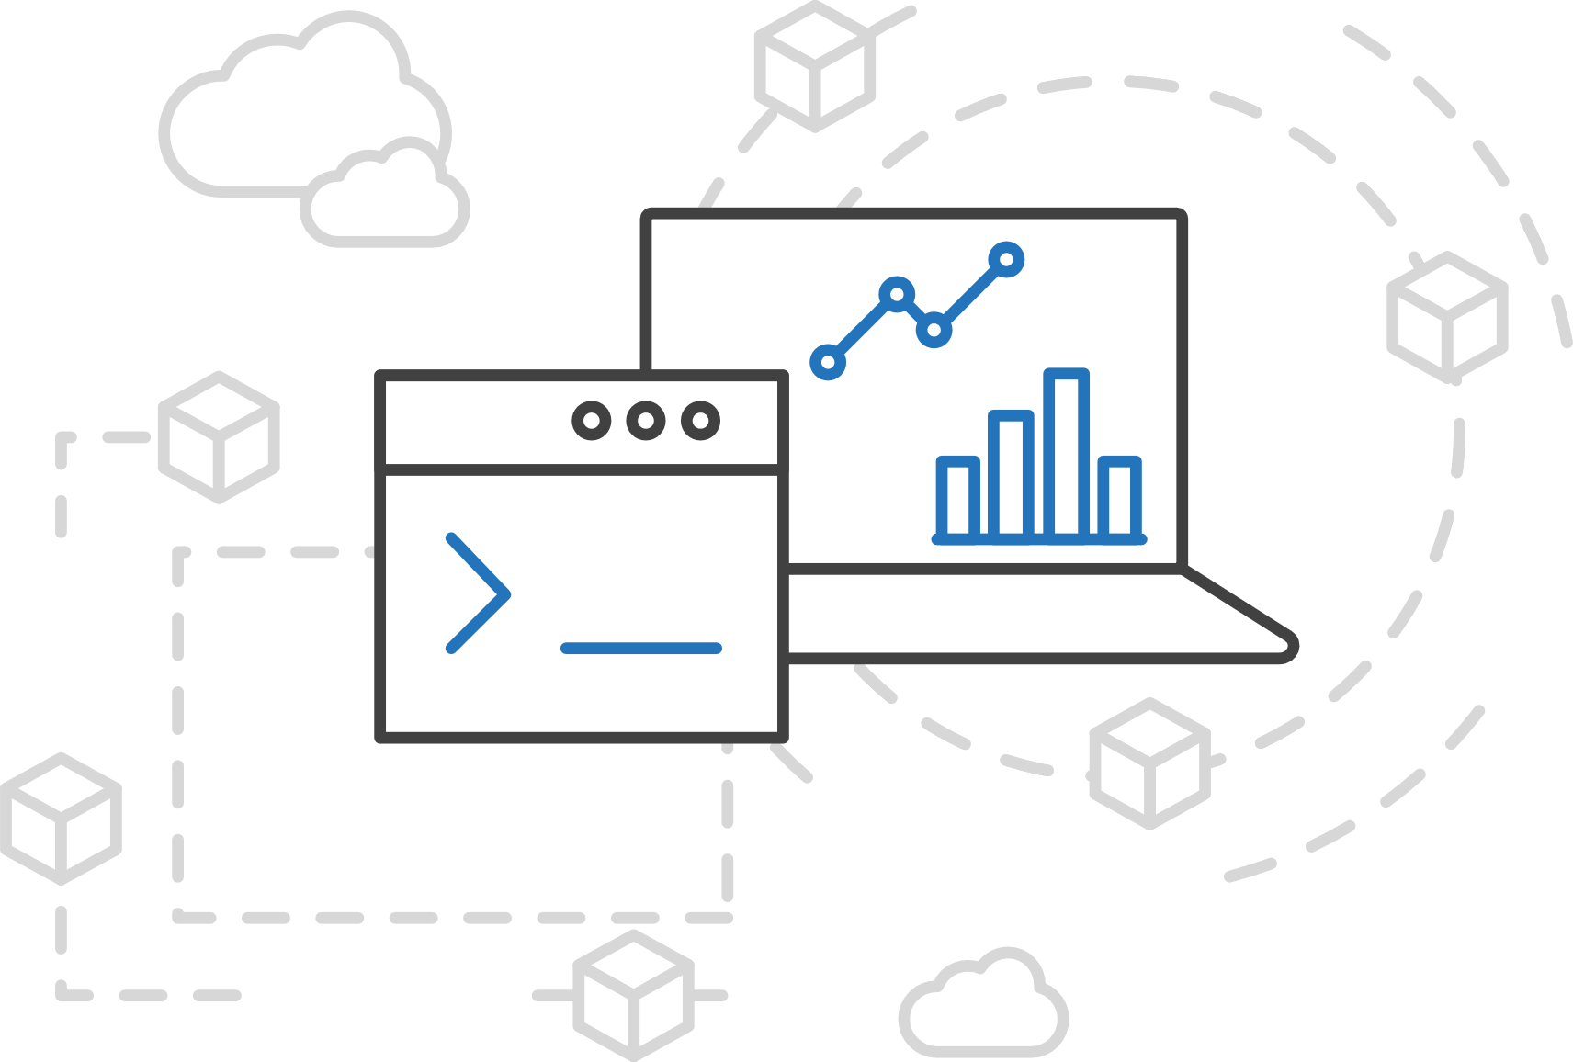
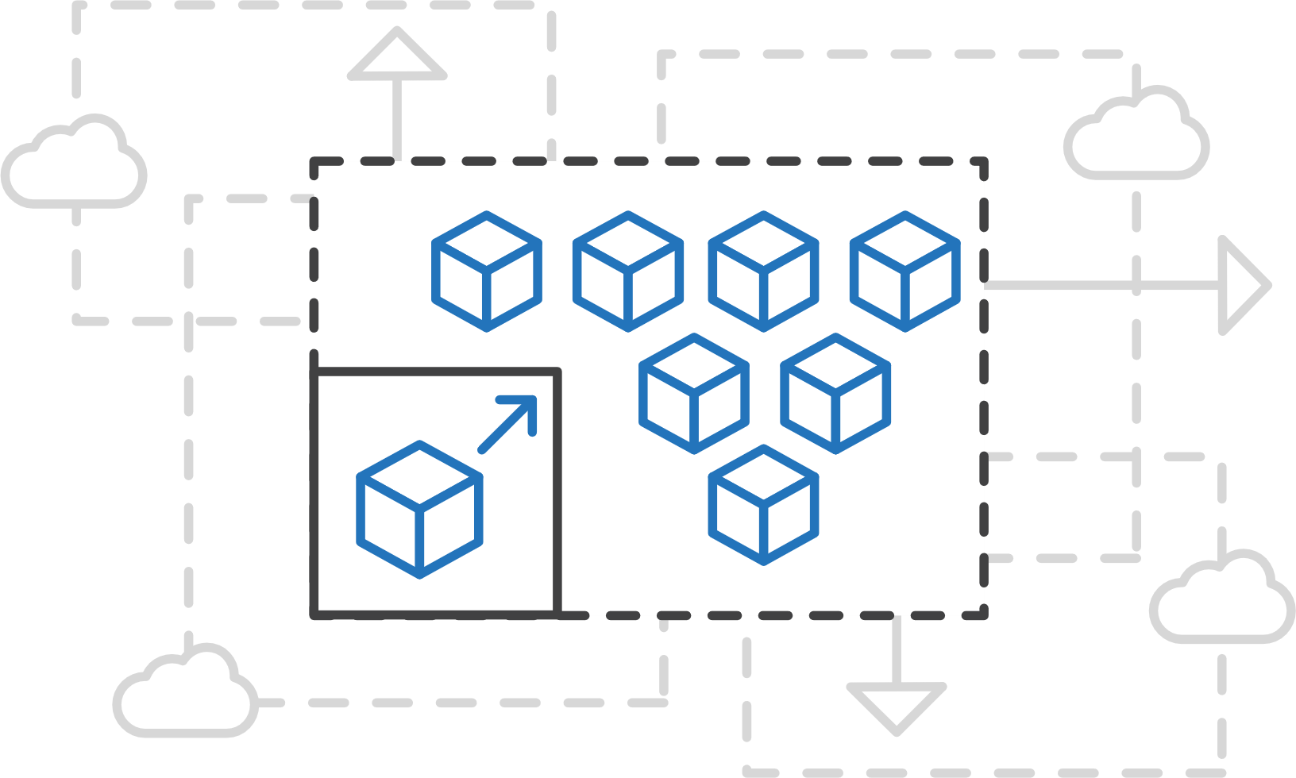
Azure Kubernetes Service (AKS)
Azure Kubernetes Service (AKS)
Simplify the deployment, management, and operations of Kubernetes
Azure Container Instances (ACI)
Azure Container Registry
Open Service Broker API (OSBA)
Focus on your containers not the infrastructure
Work how you want with open-source APIs
Scale and run applications with confidence
Release Automation Tools

Slide 51
Azure Kubernetes Service (AKS)
Azure Kubernetes Service (AKS)
A fully managed Kubernetes cluster
Azure Container Instances (ACI)
Managed control pane
Automated upgrades, patches
Easy cluster scaling
Self-healing
Cost savings
Azure Container Registry
Managed
Application architect
Applications
Open Service Broker API (OSBA)
Operations
Kubernetes
Infrastructure architect
Docker
Release Automation Tools
Azure infrastructure services

Slide 52
Azure Kubernetes Service (AKS)
Azure Kubernetes Service (AKS)
Get started easily
Azure Container Instances (ACI)
$ az aks create -g myResourceGroup -n myCluster --generate-ssh-keys
\ Running ..
$ az aks install-cli
Downloading client to /usr/local/bin/kubectl ..
$ az aks get-credentials -g myResourceGroup -n myCluster
Merged "myCluster" as current context ..
$ kubectl get nodes
NAME STATUS AGE VERSION
aks-mycluster-36851231-0 Ready 4m v1.8.1
aks-mycluster-36851231-1 Ready 4m v1.8.1
aks-mycluster-36851231-2 Ready 4m v1.8.1
Azure Container Registry
Open Service Broker API (OSBA)
Release Automation Tools

Slide 53
Azure Kubernetes Service (AKS)
Azure Kubernetes Service (AKS)
Manage an AKS cluster
Azure Container Instances (ACI)
$ az aks list –o table
Name Location ResourceGroup KubernetesRelease ProvisioningState
------------------ ---------- -------------- ------------------- -------------------
myCluster westus2 myResourceGroup 1.7.7 Succeeded
$ az aks upgrade -g myResourceGroup -n myCluster –-kubernetes-version 1.8.1
\ Running ..
$ kubectl get nodes
NAME STATUS AGE VERSION
aks-mycluster-36851231-0 Ready 12m v1.8.1
aks-mycluster-36851231-1 Ready 8m v1.8.1
aks-mycluster-36851231-2 Ready 3m v1.8.1
$ az aks scale -g myResourceGroup -n myCluster --agent-count 10
\ Running ..
Azure Container Registry
Open Service Broker API (OSBA)
Release Automation Tools

Slide 54
Features in Public Preview
Feature | Description
Hosted control plane | No VMs to manage, control plane availability handled by Azure
Nodes in new VNET | Cluster nodes provisioned into a new VNET in your subscription
Node scale up/down | Increase or decrease cluster capacity using the Azure CLI or REST API
Kubernetes patch-release upgrades | Upgrade your cluster between Kubernetes patch releases (e.g. 1.7 to 1.8)
Kubernetes minor-release upgrades | Upgrade your cluster between Kubernetes minor releases (e.g. 1.7.7 to 1.7.9)
Node OS updates (on upgrade) | Node operating system is automatically updated including most recent security fixes on every upgrade, including patch or minor release upgrades
Node OS security updates (nightly) | Nodes automatically apply operating system security patches on a nightly schedule, does not include node reboot
Persistent disks | Attach Kubernetes persistent volumes to your applications with support for Azure Files and persistent disks
Azure load balancer | Automatically provision and attach Azure Load Balancers to your Kubernetes cluster
User access profiles | Users obtain cluster access using Azure APIs rather than requiring cluster SSH access

Slide 55
AKS Roadmap: H1 2018
Feature | Description
Existing VNET | Deploy cluster nodes into an existing VNET
VNET Service Endpoint (Alpha) | Hosted control plane components accessible via VNET service endpoint, not public endpoint
Kubernetes RBAC | Clusters ship with Kubernetes RBAC enabled by default
Network Policy | Kubernetes network policy enforced by Calico
Azure CNI | Pod addresses assigned by Azure CNI, IPAM only
AAD Authentication | Cluster users authenticate to Kubernetes through AAD
Scale and performance testing | Scale and performance testing of customer clusters, scale targets of 10, 50, 200+
Archive cluster audit log | Archive Kubernetes audit log to Azure storage

Slide 56
AKS Roadmap: H2 2018 and beyond
Node auto-scaling | Application Load Balancer Support
Windows | Node Pool Data Disk Support (diskProfile)
Hybrid clusters / Multiple node pools | Azure Monitor integration
Access profiles rotation | Azure Stack
AKS secret rotation | GPU Support for AKS
Kubernetes early-access
Node auth via MSI
Kubernetes Federation Support

Slide 57
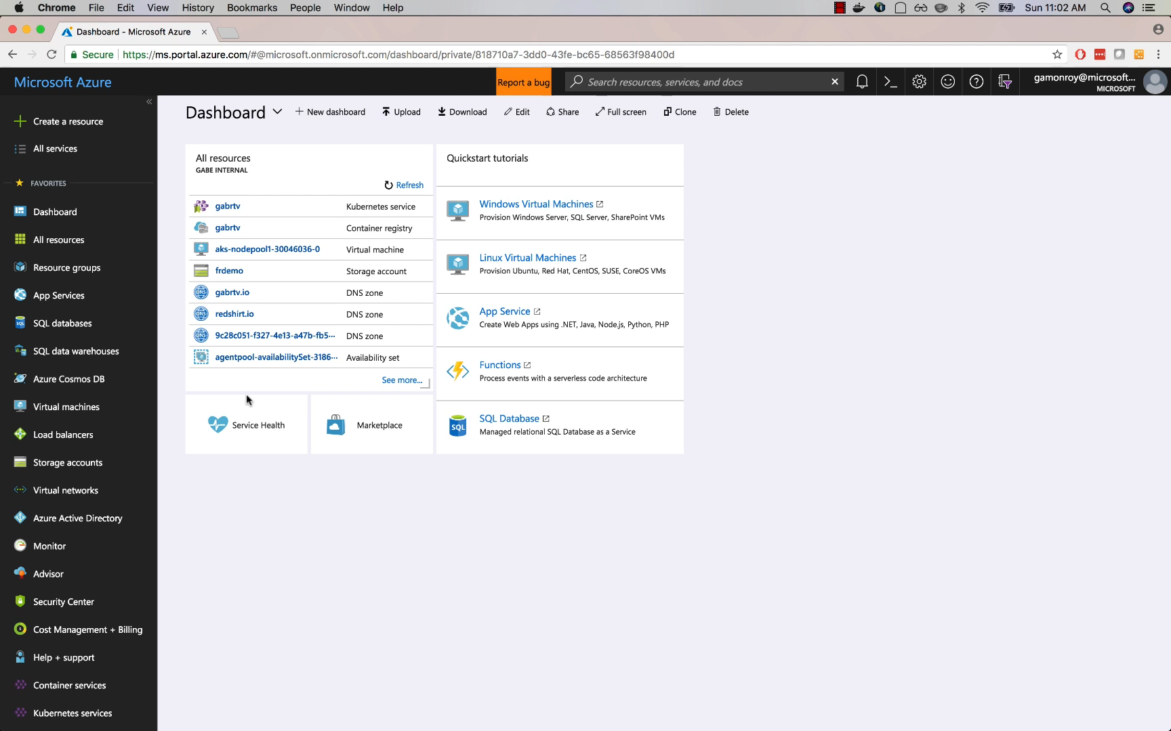
Azure Kubernetes Service (AKS)
Azure Container Instances (ACI)
Azure Container Registry
Open Service Broker API (OSBA)
Release Automation Tools

Slide 58
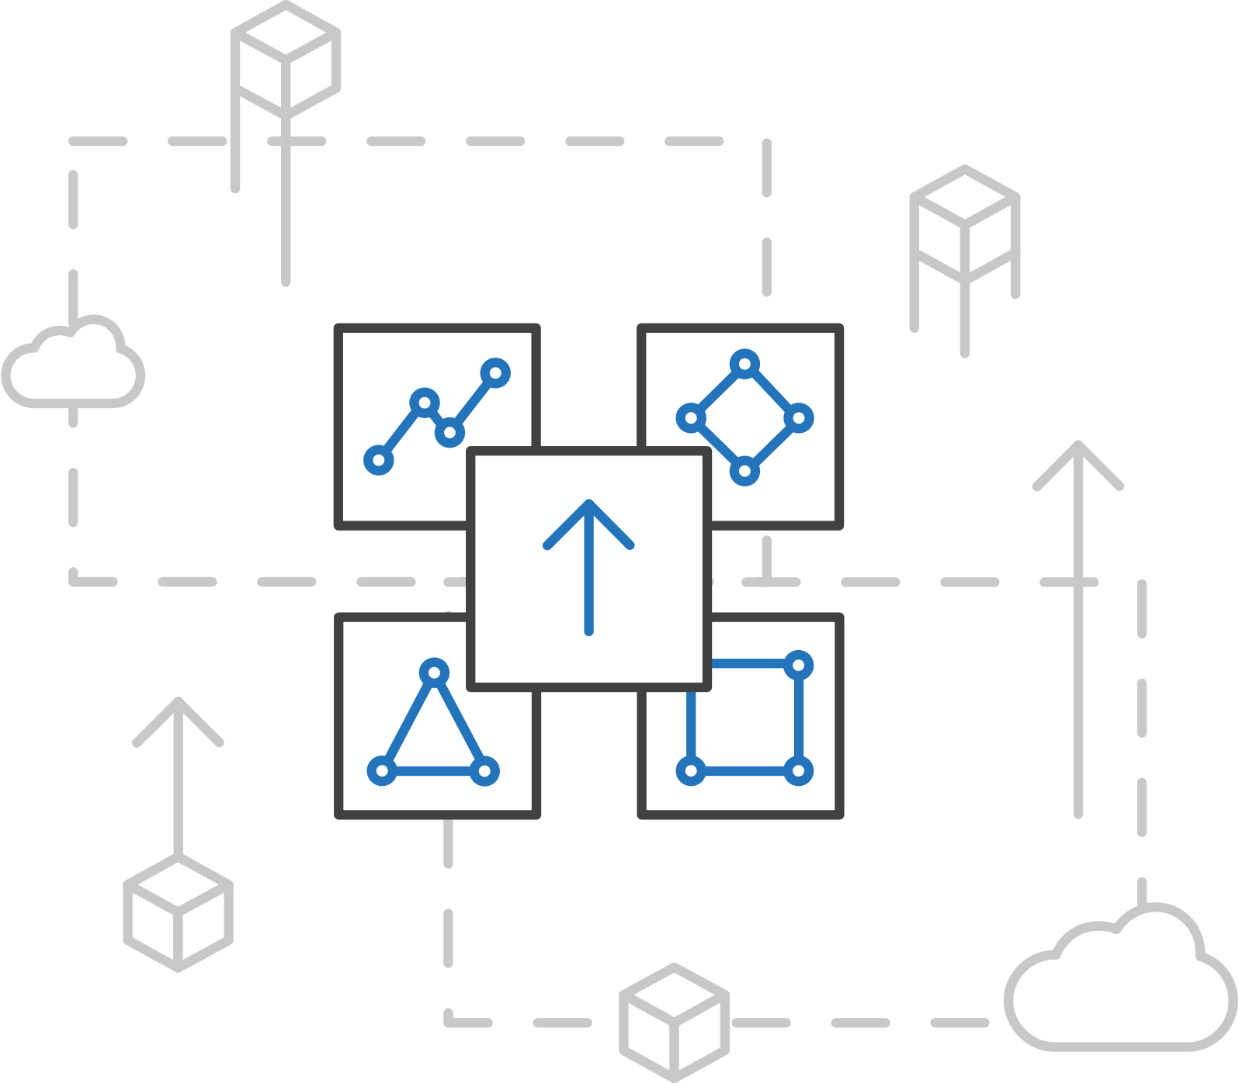
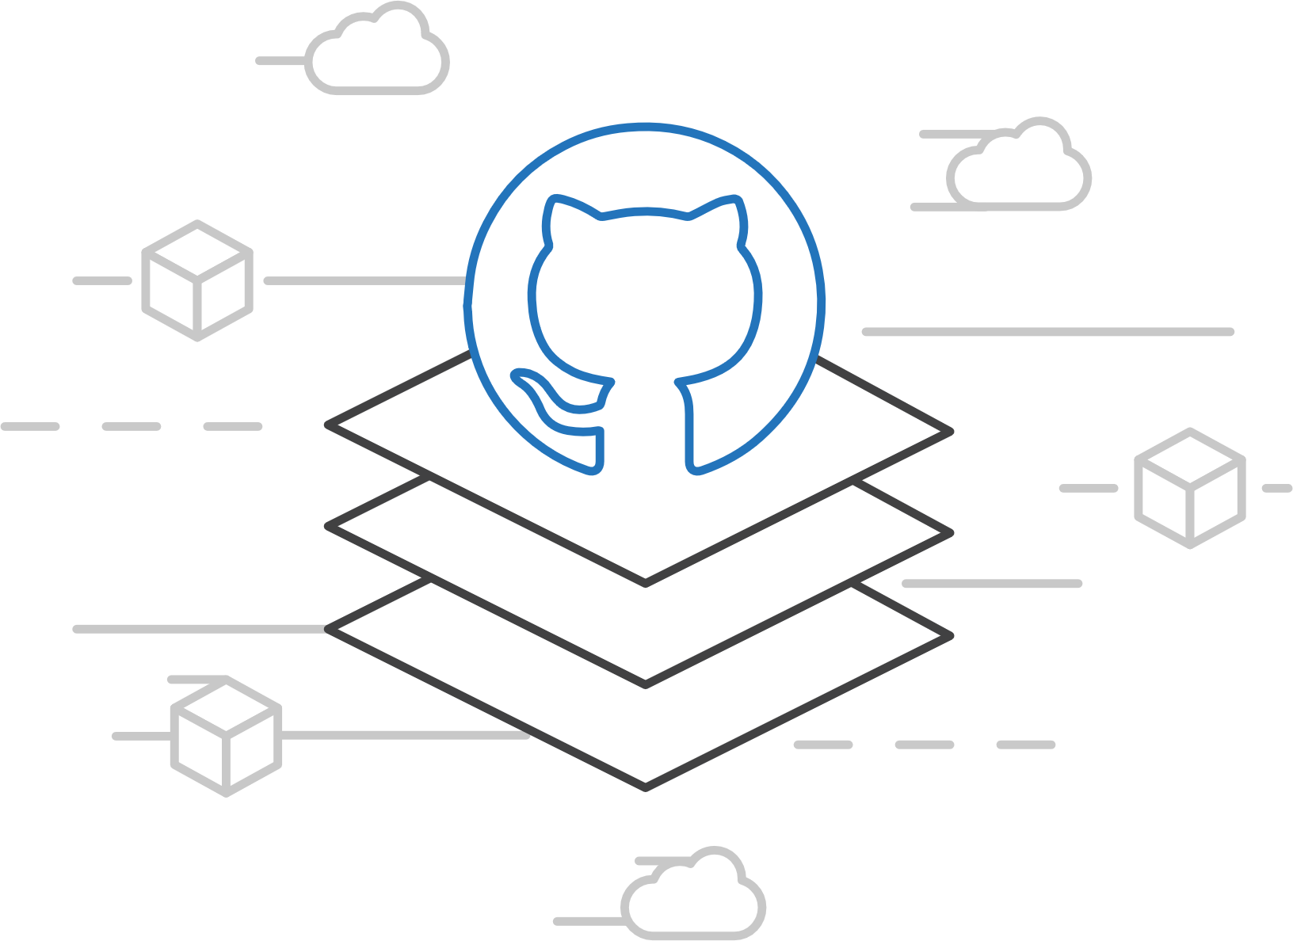
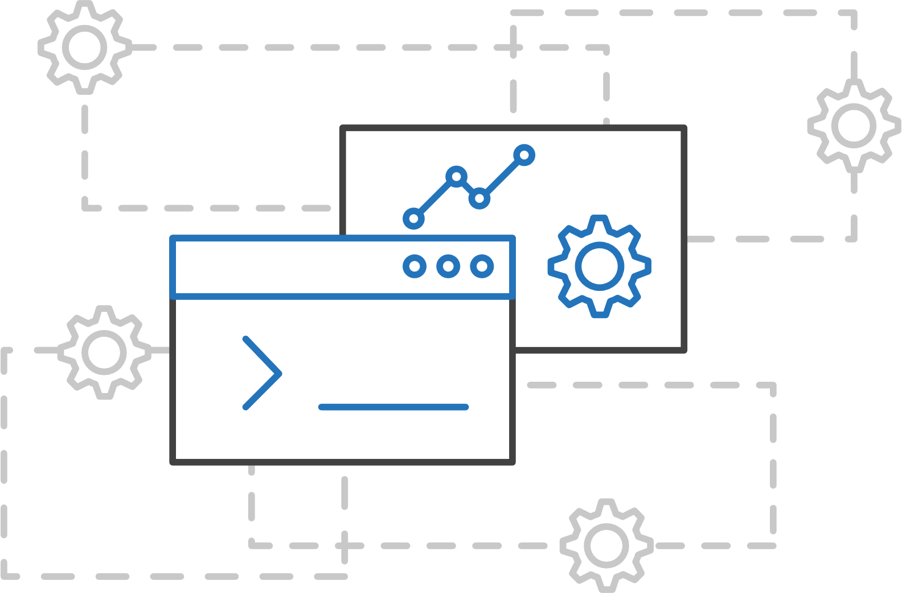
Azure Kubernetes Service (AKS)
Azure Kubernetes Service (AKS)
Azure Kubernetes Service Engine (ACS-Engine)
Azure Container Instances (ACI)
Azure Container Registry
Open Service Broker API (OSBA)
A proving ground for new features
Enables custom deployments
Available on GitHub
Release Automation Tools

Slide 59
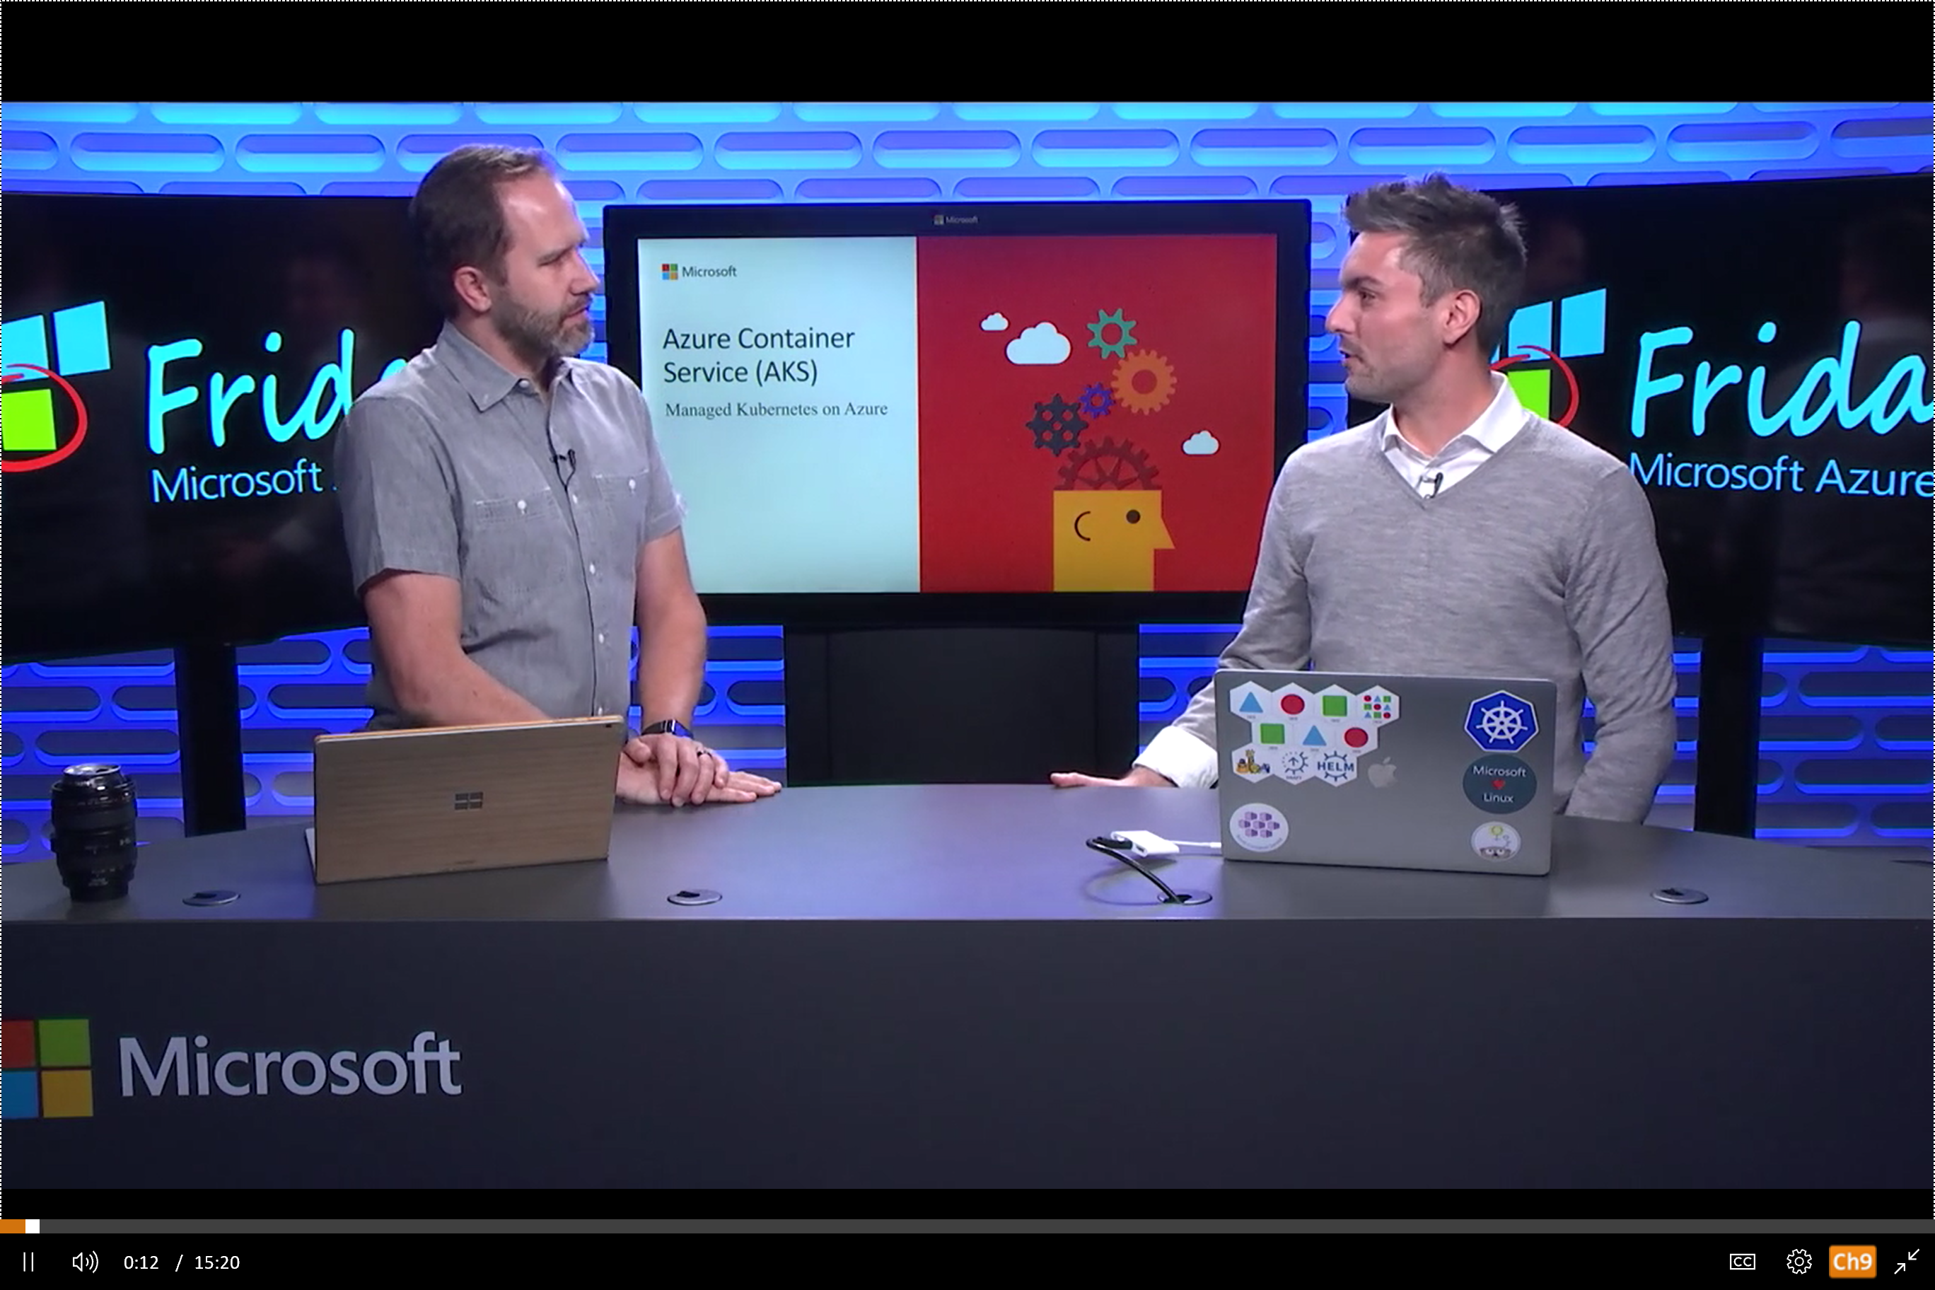
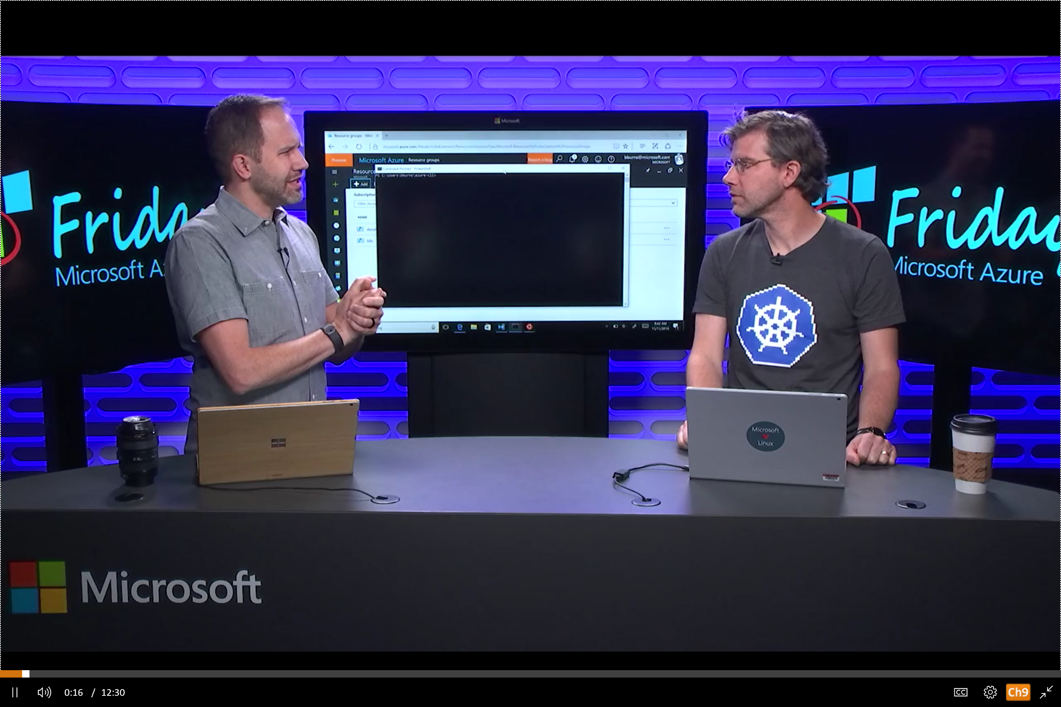
Azure Kubernetes Service (AKS)
Azure Kubernetes Service (AKS)
Resources
Azure Container Instances (ACI)
Azure Kubernetes Service (AKS) webpage
AKS videos
AKS technical documentation
AKS pricing details
AKS roadmap
Azure Kubernetes Service Engine: Github
Container Orchestration Simplified with AKS
Azure Container Registry
Open Service Broker API (OSBA)
Kubernetes Support in Azure Kubernetes Services
Release Automation Tools

Slide 60
Demo
Cluster Creation
Get Nodes
Get Namespaces
Get Deployments
Get Pods
Get Services

Slide 61
Labs: 3, 4, 5 https://github.com/OSSCanada/aks_partnerworkshop

Slide 62
Kubernetes Concepts

Slide 63
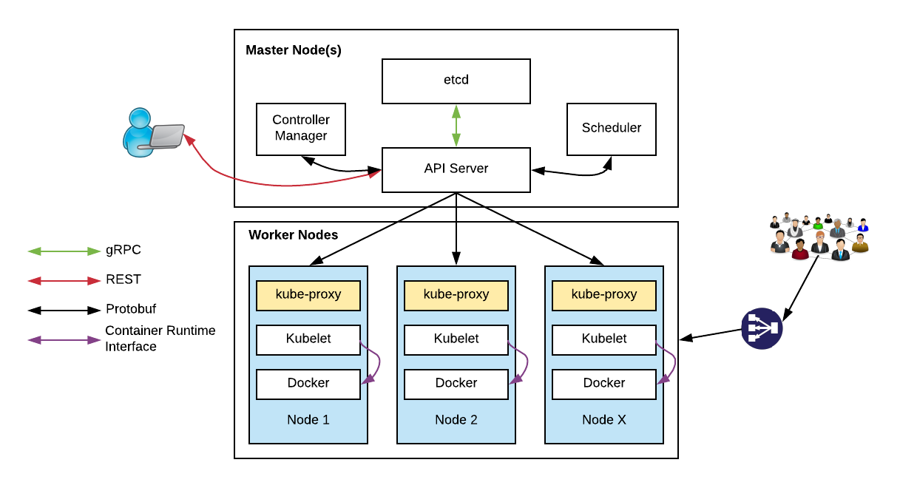
Kubernetes Architecture

Slide 64
Kubernetes Architecture Components
api-server
etcd
master components
controller-manager
scheduler
kubelet
kube-proxy
node components
container runtime (e.g. Docker, rkt)
dns

Slide 65
Kubernetes Architecture Components
api-server
etcd
master components
controller-manager
scheduler
* Azure Managed
kubelet
kube-proxy
node components
docker
dns

Slide 66
kubectl: CLI to run commands against a Kubernetes cluster
Swiss Army Knife: run deployments, exec into containers, view logs, etc.
Syntax largely the same as docker
Pronounced “koob sea tee el”…
Or “koob cuddle”
Notes:
Borg: The first unified container-management system developed at Google
It was built to manage both long-running services and batch jobs

Slide 67
Kubernetes Resources
pod
deployment
service
replica set
ingress
daemon set, job
namespace
secret, config-map

Slide 68
Kubernetes Resources
pod
deployment
service

Slide 69
What is a Pod?
Pod is the basic building block in kubernetes
Pods are how containers are delivered
Can be multiple containers (eg - side car)
Encapsulates container(s), storage, network IP, and options on how to run
Use Deployment resources to deploy
ReplicaSet
StatefulSet
DaemonSet
Job
InitContainer

Slide 70
What is a Deployment?
Provides declarative updates for Pods and Replica Sets
Deployment describes ”desired state”
Can:
Create deployment to rollout ReplicaSet
Declare new state for pods (eg – new imageTag)
Rollback to earlier state
Scale up/down
Check rollout history
Clean-up

Slide 71
What is a Service?
Defines a logical set of pods (your microservice)
Essentially a virtual load balancer in front of pods

Slide 72
Kubernetes manifest: Pod
apiVersion: v1
kind: Pod
metadata:
name: redis-django
labels:
app: web
spec:
containers:
- name: key-value-store
image: redis
ports:
- containerPort: 6379
- name: frontend
image: django
ports:
- containerPort: 8000
Notes:
Borg: The first unified container-management system developed at Google
It was built to manage both long-running services and batch jobs

Slide 73
Interact with pods
$ kubectl get po --all-namespaces
$ kubectl describe po/my-pod
$ kubectl logs my-pod
# Run bash in container
$ kubectl exec -it my-pod bash

Slide 74
Kubernetes manifest: Deployment
apiVersion: apps/v1beta1
kind: Deployment
metadata:
name: smackweb-deploy
spec:
replicas: 5
template:
metadata:
labels:
app: smackweb
spec:
containers:
- name: smackweb
image: chzbrgr71/smackweb
ports:
- containerPort: 8080
Notes:
Borg: The first unified container-management system developed at Google
It was built to manage both long-running services and batch jobs

Slide 75
Service Types
ClusterIP:
Exposes the service on a cluster-internal IP. Choosing this value makes the service only reachable from within the cluster
NodePort:
Exposes the service on each Node’s IP at a static port (the NodePort)
Connect from outside the cluster by requesting <NodeIP>:<NodePort>
LoadBalancer:
Exposes the service externally using a cloud provider’s load balancer

Slide 76
Kubernetes manifest: Service
apiVersion: v1
kind: Service
metadata:
name: my-service
spec:
selector:
app: MyApp
type: ClusterIP
ports:
- protocol: TCP
port: 80
targetPort: 9376
Notes:
Borg: The first unified container-management system developed at Google
It was built to manage both long-running services and batch jobs

Slide 85
pod
pod
rating-api
rating-web
port
3000
port
8080
pod
rating-db
port
27017

Slide 86
Deployment
label
app=heroes-web , tier=web
image
azurecr.io/rating-web:v1
pod
heroes-web-1
port
8080
port
pod
heroes-web-2
port
8080
heroes-web

Slide 87
Deployment
label
app=heroes-web, tier=web
image
azurecr.io/rating-web:v1
pod
Service
heroes-web-1
port
8080
Heroes-web
pod
port
selector
app=heroes-web
heroes-web-2
port
8080:8080
port
8080
IP
10.0.2.20
heroes-web

Slide 88
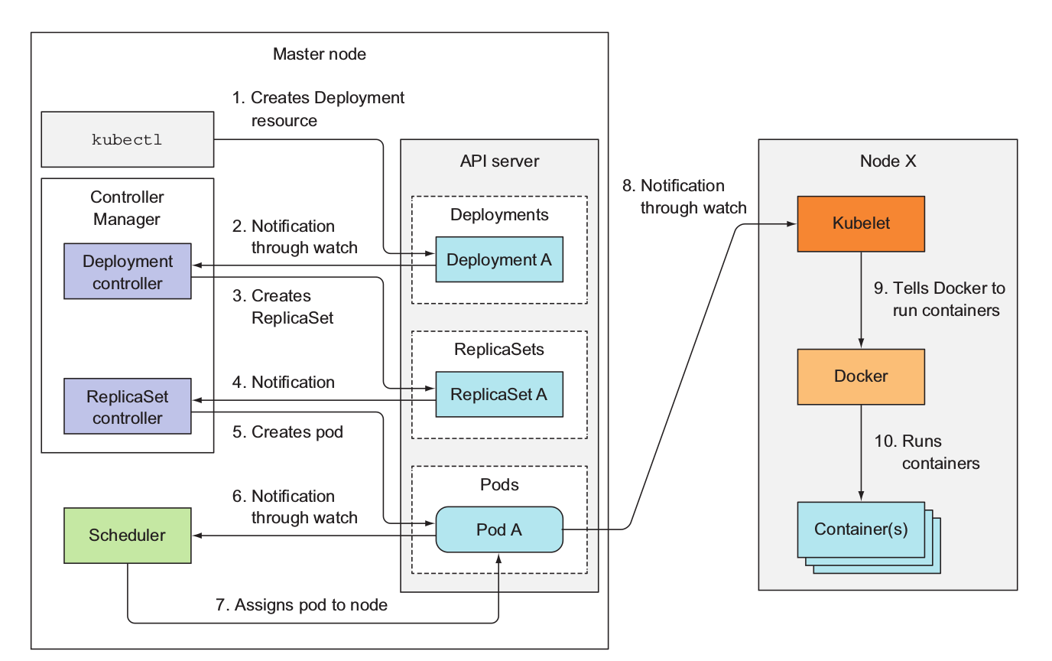
Deployment Events
From “Kubernetes in Action” by Manning

Slide 89
Demo
Create Pod
Create Deployment
Add Service to Deployment
Rolling Update of Deployment

Slide 90
Azure Container Instances (ACI)
Azure Container Registry
Open source community
Azure Kubernetes Service (AKS)
Release automation tools
Containers 101
Getting started
Azure container technology
Open Service Broker for Azure (OSBA)
Customer success stories
Container orchestration
Azure Container Instances (ACI)

Slide 91
Azure Container Instances (ACI)
Azure Kubernetes Service (AKS)
Azure Container Instances (ACI)
OSBA
App Service
Azure Container Registry (ACR)
Partner services
Azure services
PaaS
Azure Container Registry
OpenShift
SQL Database
Azure Kubernetes Service (AKS)
Service Fabric
Batch
Pivotal Cloud Foundry
Redis Cache
ACS Engine
Open Service Broker API (OSBA)
Docker Enterprise Edition
CosmosDB
Virtual kubelet
Mesosphere DC/OS
And more!
Azure Container Instances (ACI)
Azure Virtual Machines
Virtual Machine Scale Sets (VMSS)
Release Automation Tools
Azure
IaaS

Slide 92
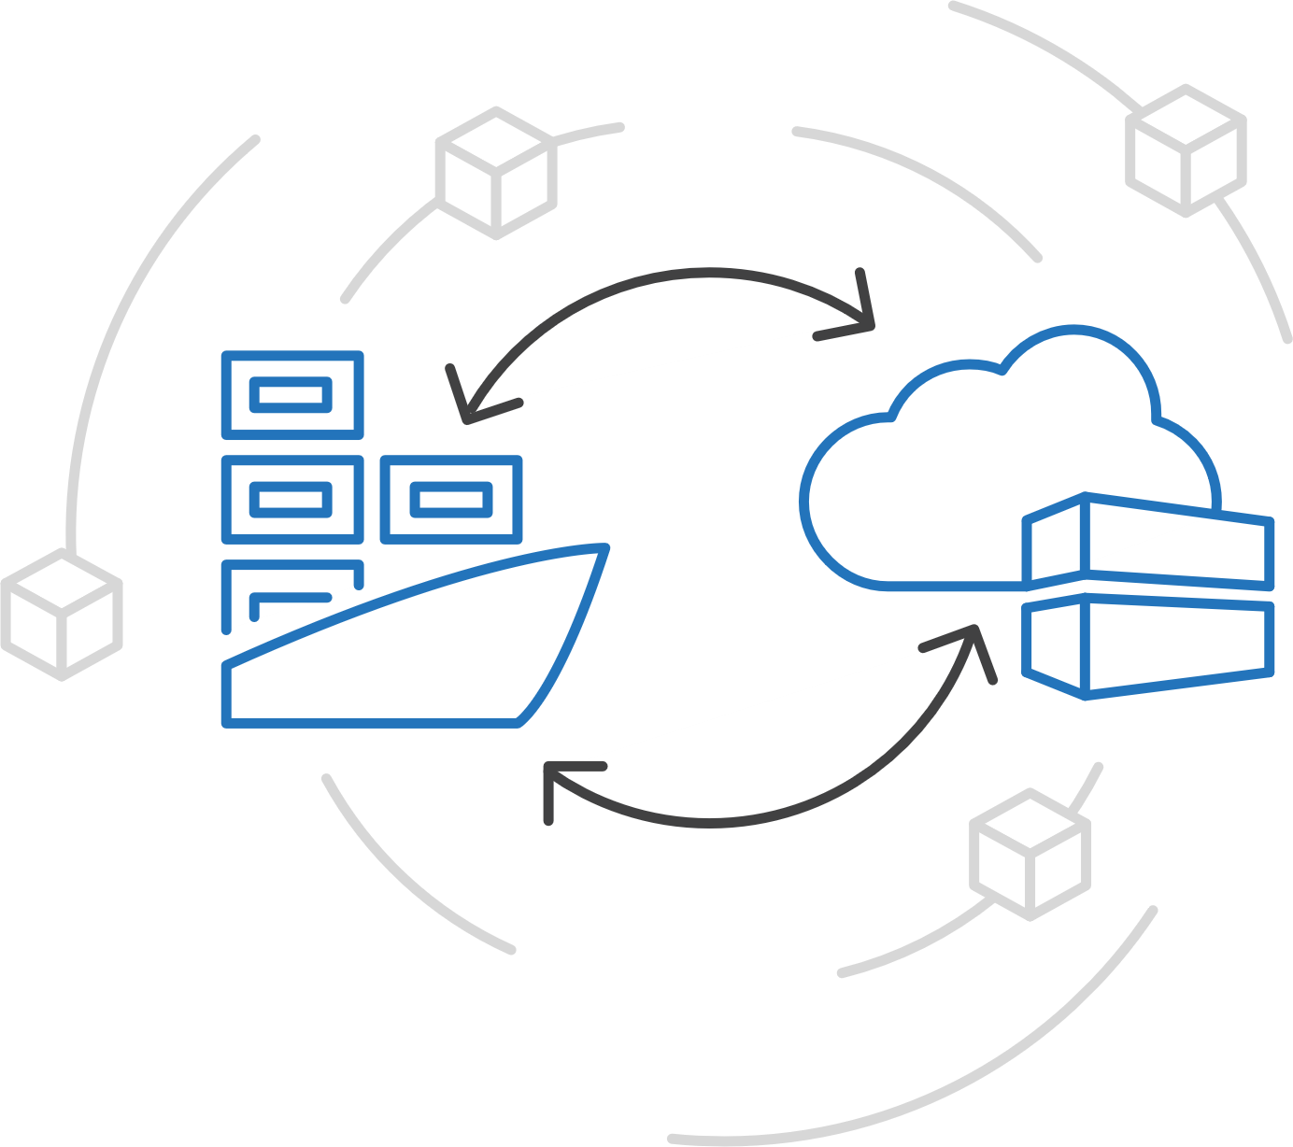
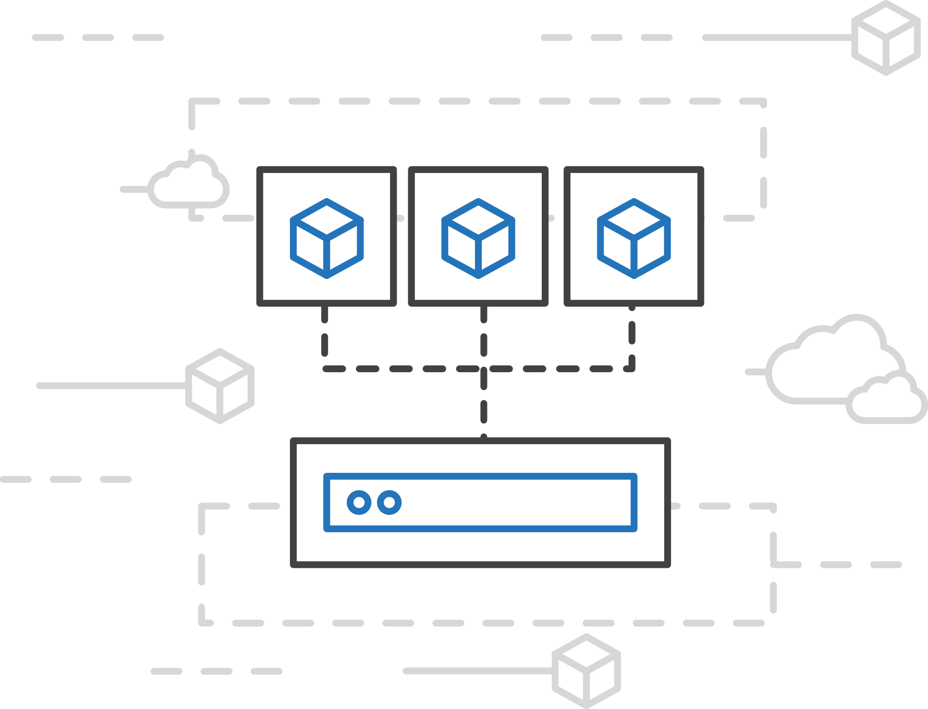
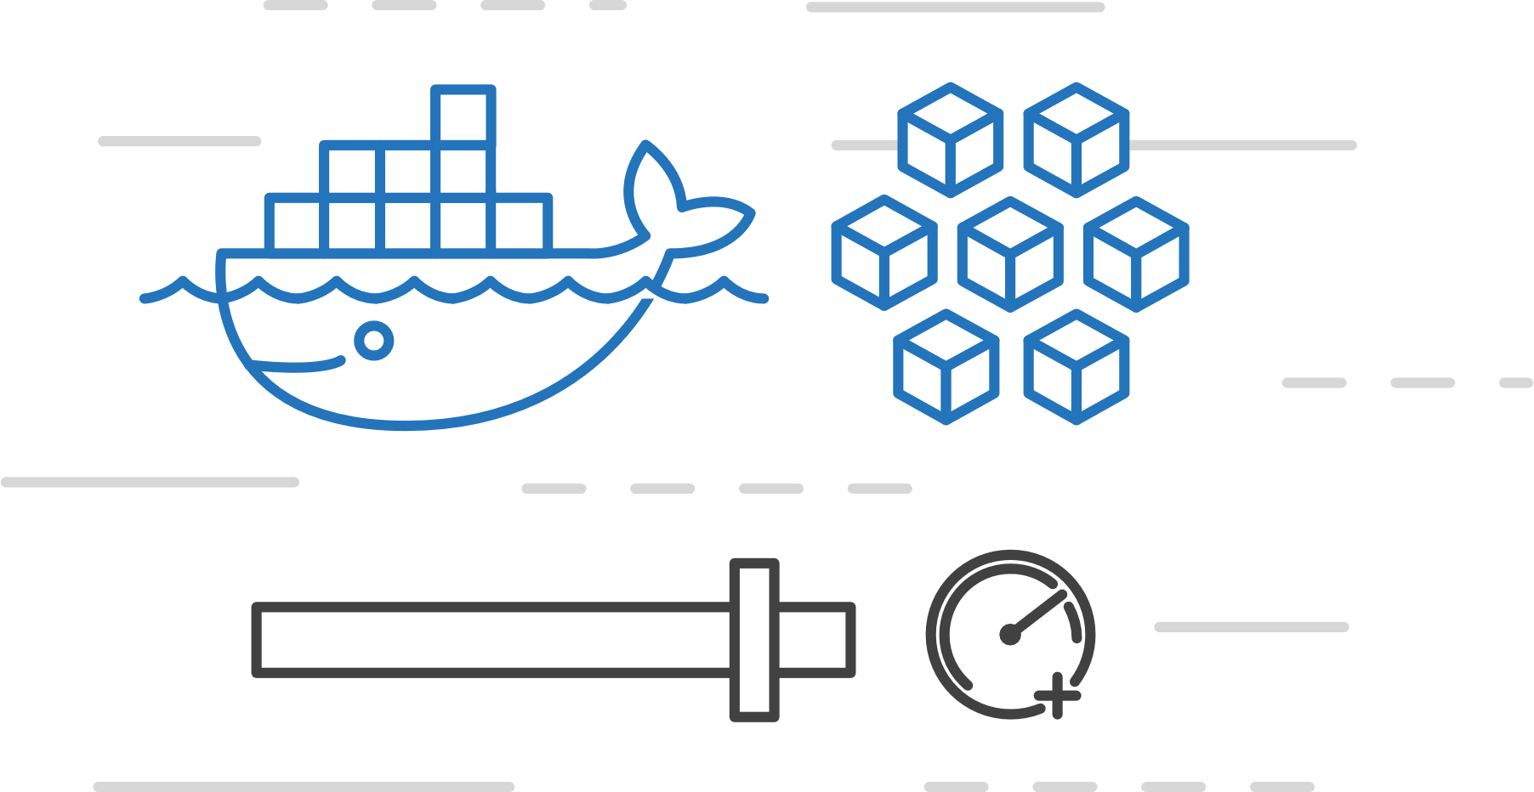
Azure Container Instances (ACI)
Azure Kubernetes Service (AKS)
Easily run containers on Azure with a single command
Azure Container Instances (ACI)
Azure Container Registry
Open Service Broker API (OSBA)
Start using containers right away
Cloud-scale container capacity
Hyper-visor isolation
Release Automation Tools

Slide 93
Azure Container Instances (ACI)
Azure Kubernetes Service (AKS)
Get started easily
Azure Container Instances (ACI)
$ az container create --name mycontainer --image microsoft/aci-helloworld --resource-group myResourceGroup --ip-address public
"ipAddress": {
"ip": "52.168.86.133",
"ports": [...]
},
"location": "eastus",
"name": "mycontainer",
"osType": "Linux",
"provisioningState": "Succeeded",
$ curl 52.168.86.133
<html>
<head>
<title>Welcome to Azure Container Instances!</title>
</head>
Azure Container Registry
Open Service Broker API (OSBA)
Release Automation Tools

Slide 94
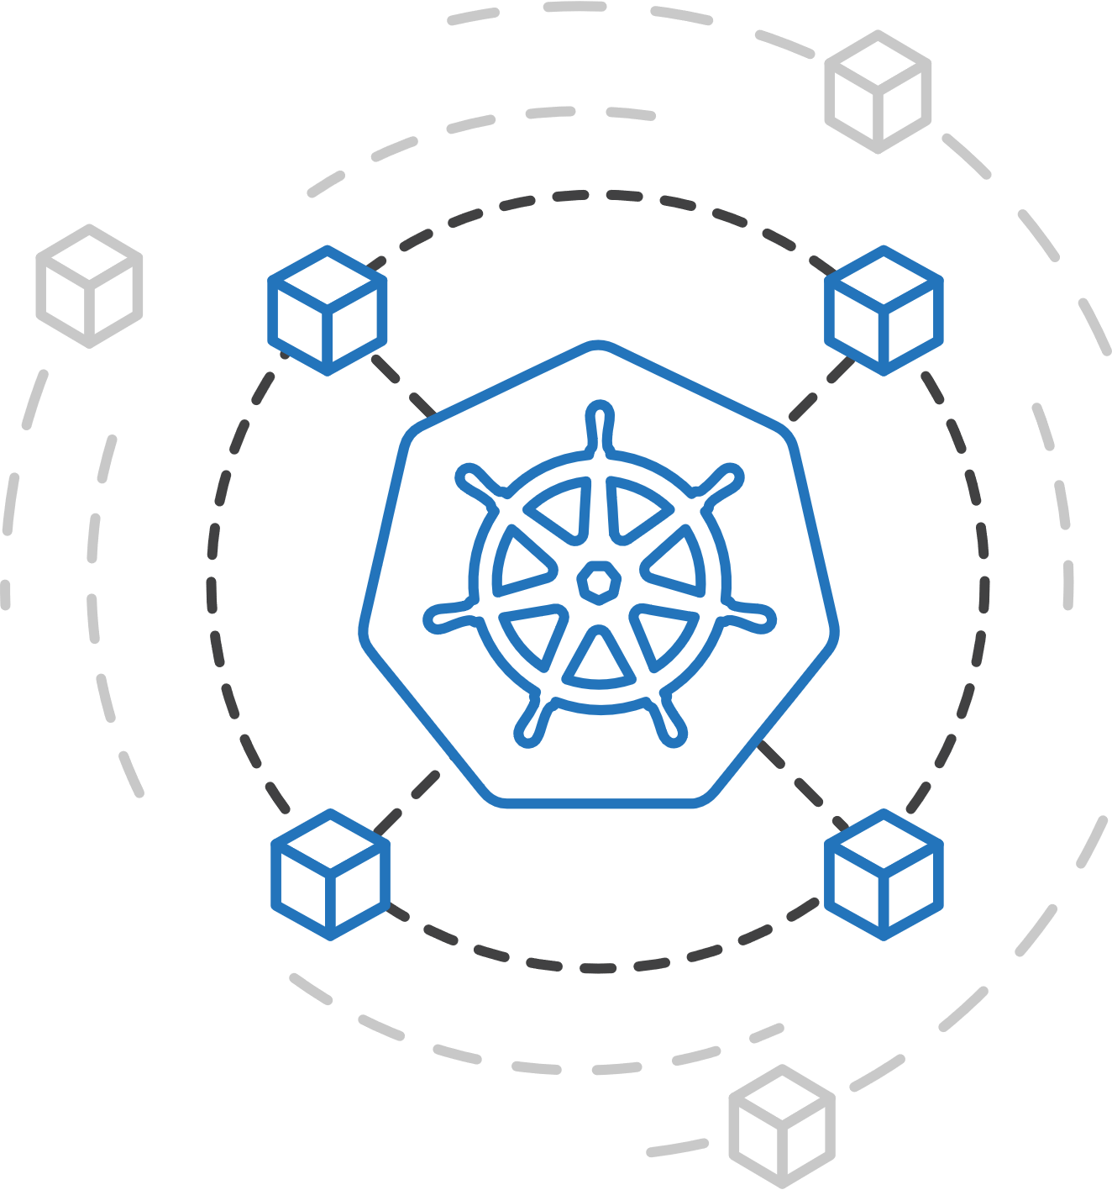
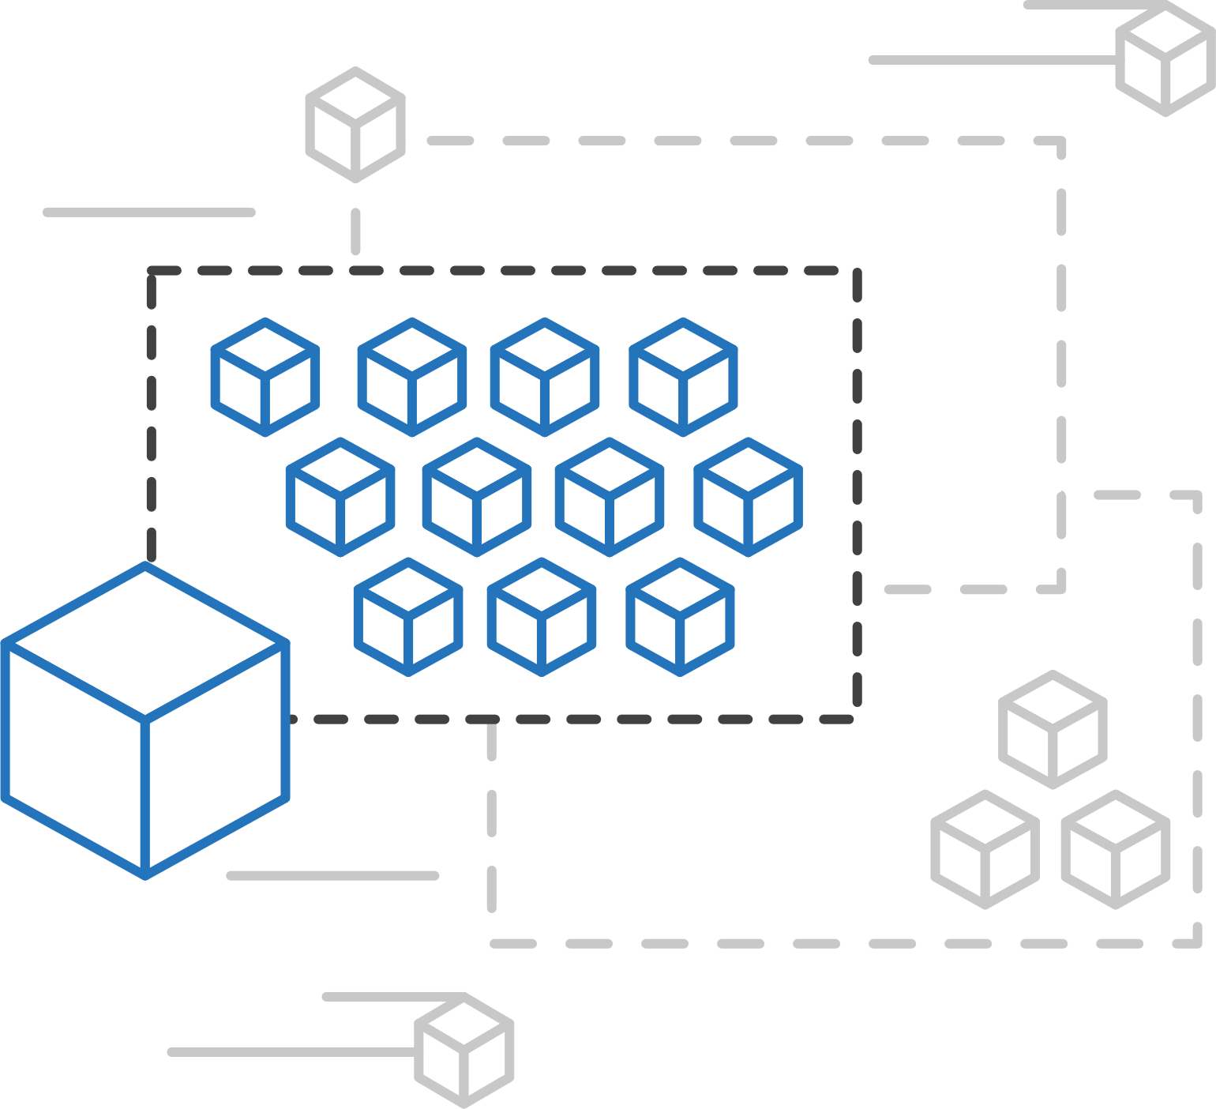
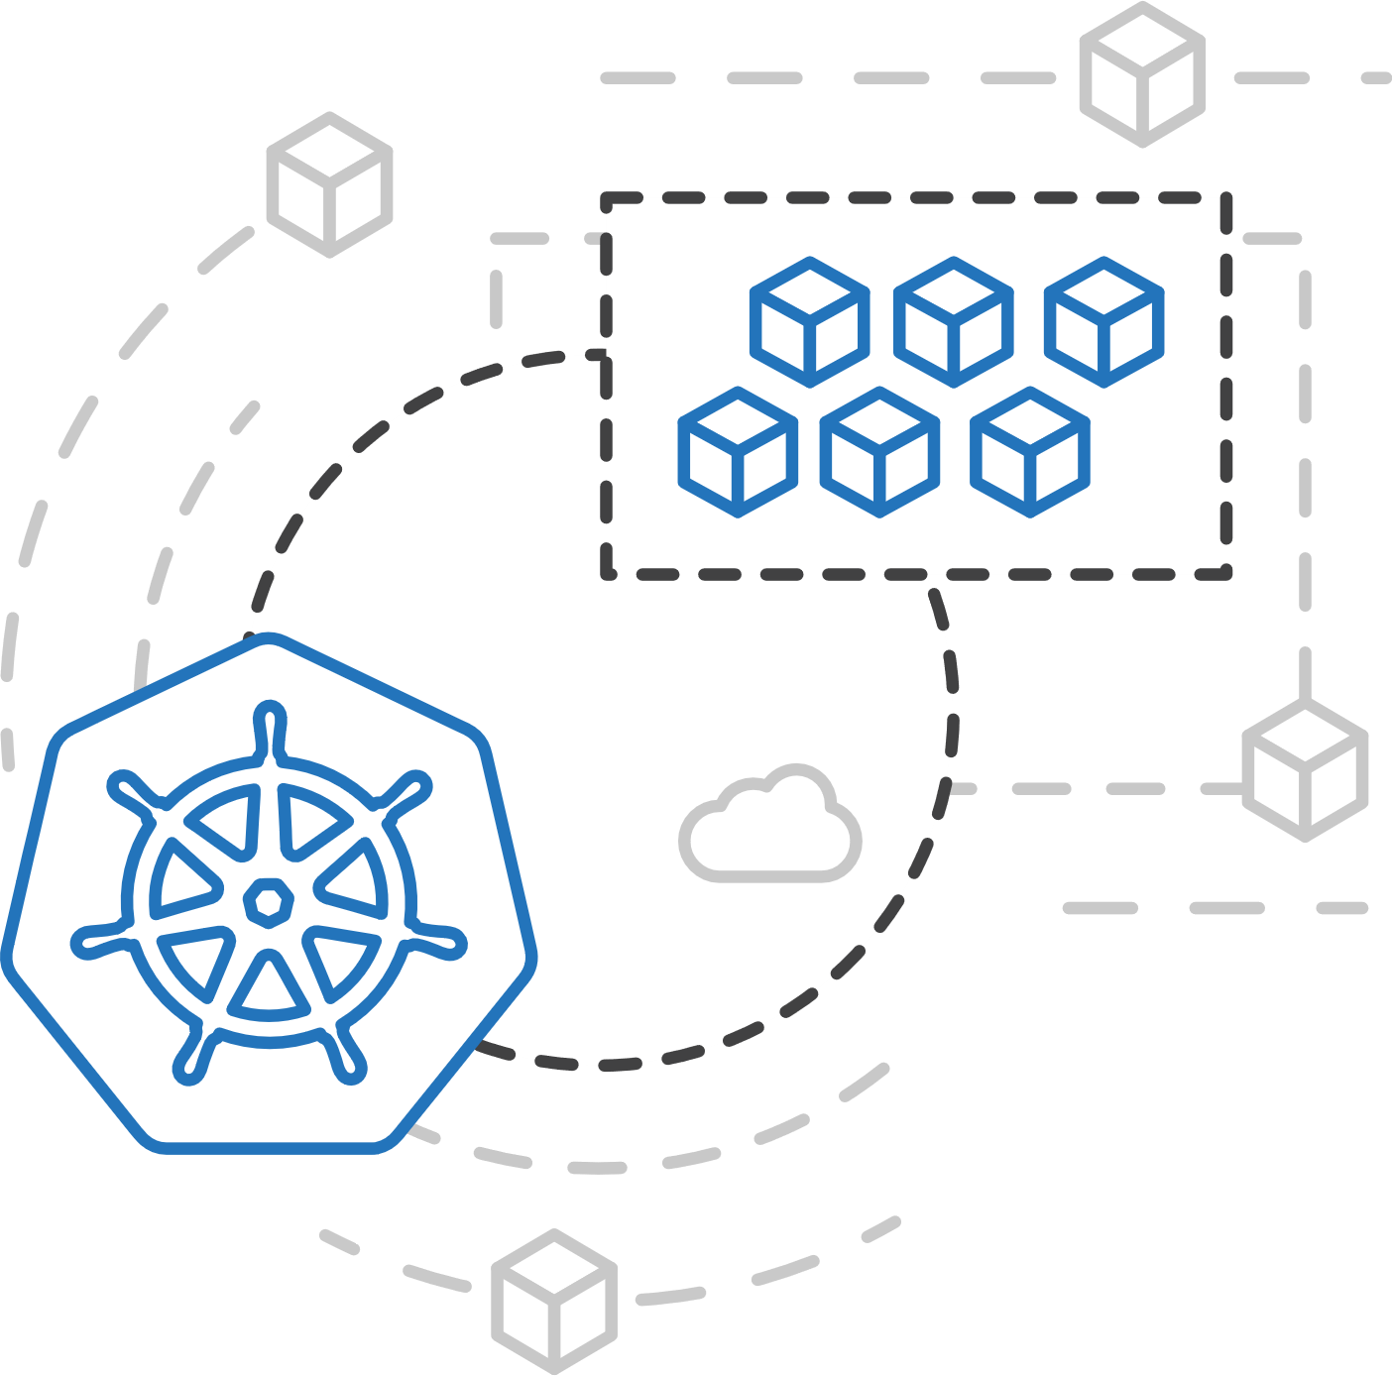
Azure Kubernetes Service (AKS)
Azure Container Instances (ACI)
ACI Connector for Kubernetes
Azure Container Instances (ACI)
Azure Container Registry
Open Service Broker API (OSBA)
Kubernetes provides rich orchestration capabilities
ACI provides infinite container-based scale
The ACI Connector for K8s brings them together
Release Automation Tools

Slide 95
Azure Container Instances (ACI)
Azure Kubernetes Service (AKS)
Bursting with the ACI Connector
Azure Container Instances (ACI)
VM
VM
Pod
Waste
Pod
Pod
Pod
Waste
Pod
Pod
Pod
Pod
Azure Container Registry
Azure Container Instances (ACI)
Pod
Pod
Pod
Pod
Pod
Application architect
Kubernetes control pane
ACI Connector
Pod
Pod
Pod
Pod
Pod
Pod
Pod
Pod
Pod
Pod
Open Service Broker API (OSBA)
Pod
Pod
Pod
Pod
Pod
Deployment/ tasks
Pod
Pod
Pod
Pod
Pod
Infrastructure architect
Release Automation Tools
Pod
Waste
Pod
Pod
Pod
Waste
Pod
Pod
Pod
Pod
VM
VM

Slide 96
Azure Kubernetes Service (AKS)
Azure Container Instances (ACI)
Virtual Kubelet
Azure Container Instances (ACI)
Kubernetes API
Azure Container Registry
Node
Node
Node
Node
virtual kubelet
Kubelet
Kubelet
Kubelet
Kubelet
Open Service Broker API (OSBA)
Release Automation Tools
Typical kubelets implement the pod and container operations for each node as usual.
Virtual kubelet registers itself as a “node” and allows developers to program their own behaviors for operations on pods and containers.

Slide 97
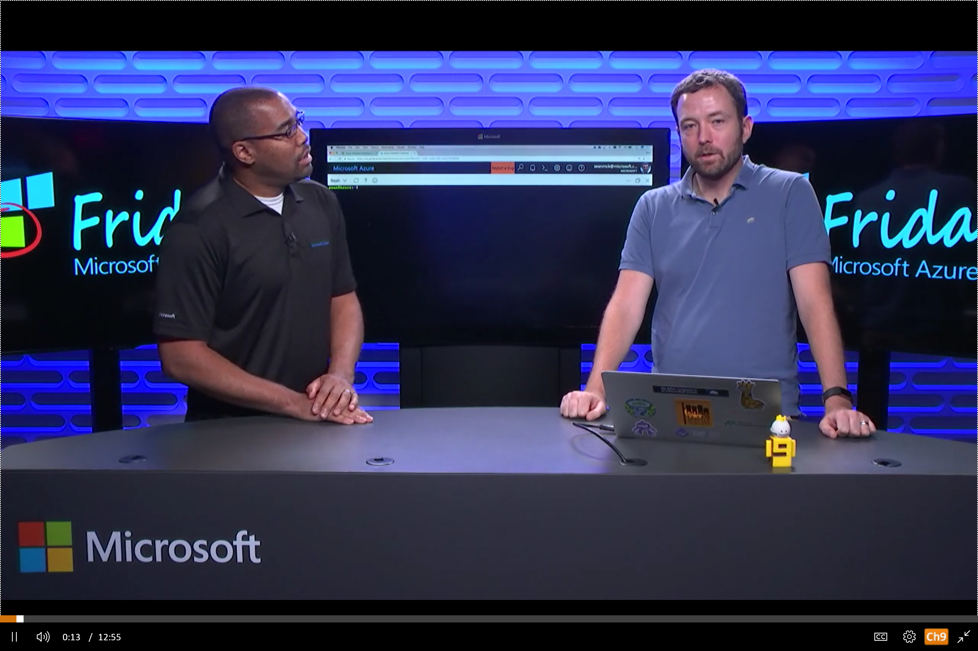
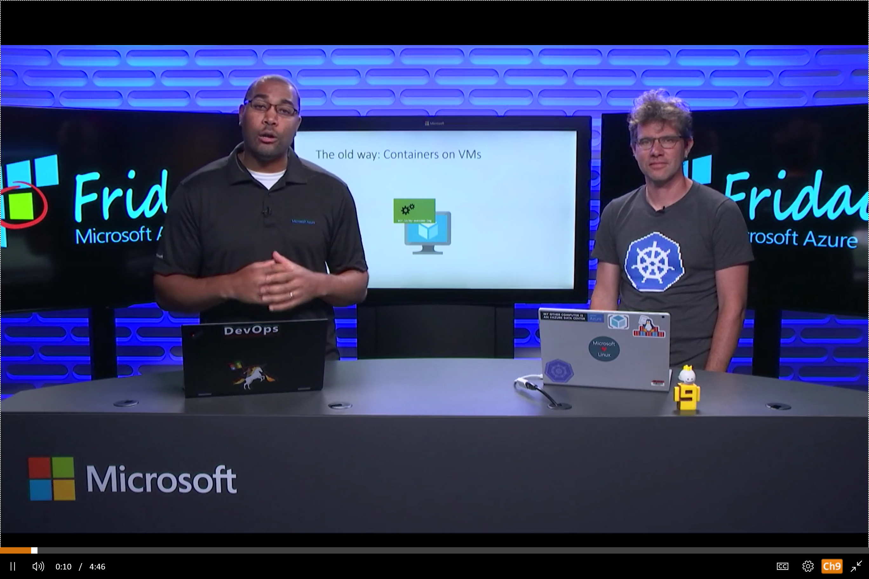
Azure Container Instances (ACI)
Azure Kubernetes Service (AKS)
Resources
Azure Container Instances (ACI)
Azure Container Instances (ACI) webpage
ACI videos
ACI technical documentation
ACI pricing details
ACI roadmap
Azure Container Instances
Azure Container Registry
Open Service Broker API (OSBA)
Using Kubernetes with Azure Container Instances
Release Automation Tools

Slide 98
Demo
ACI Deployment

Slide 99
Azure Container Registry
Azure Container Registry
Open source community
Azure Kubernetes Service (AKS)
Release automation tools
Containers 101
Getting started
Azure container technology
Open Service Broker for Azure (OSBA)
Customer success stories
Container orchestration
Azure Container Instances (ACI)

Slide 100
Azure Container Registry
Azure Kubernetes Service (AKS)
Azure Container Instances (ACI)
OSBA
App Service
Azure Container Registry (ACR)
Partner services
Azure services
PaaS
Azure Container Registry
OpenShift
SQL Database
Azure Kubernetes Service (AKS)
Service Fabric
Batch
Pivotal Cloud Foundry
Redis Cache
ACS Engine
Open Service Broker API (OSBA)
Docker Enterprise Edition
CosmosDB
Virtual kubelet
Mesosphere DC/OS
And more!
Azure Container Instances (ACI)
Azure Virtual Machines
Virtual Machine Scale Sets (VMSS)
Release Automation Tools
Azure
IaaS

Slide 101
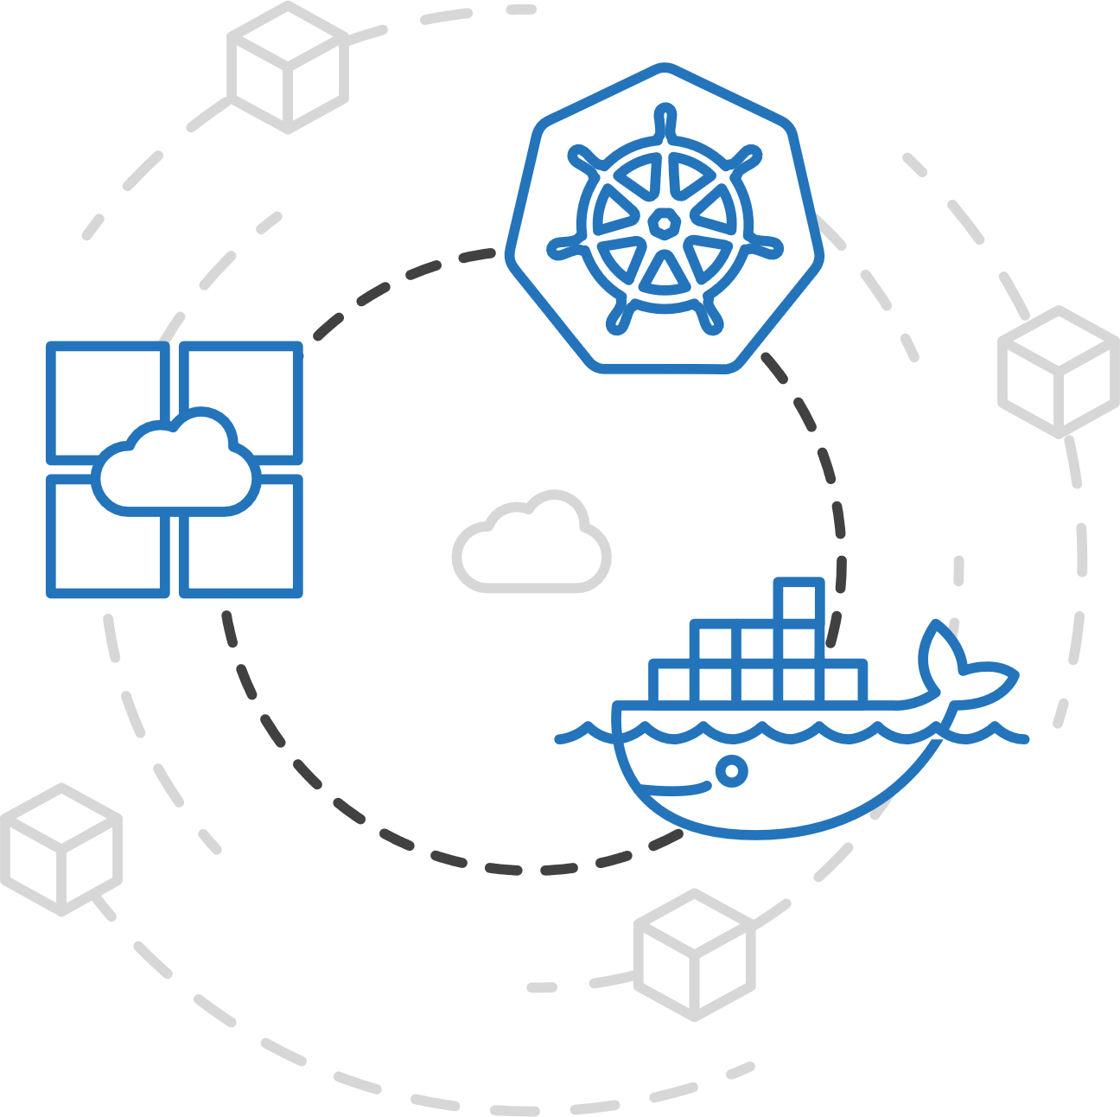
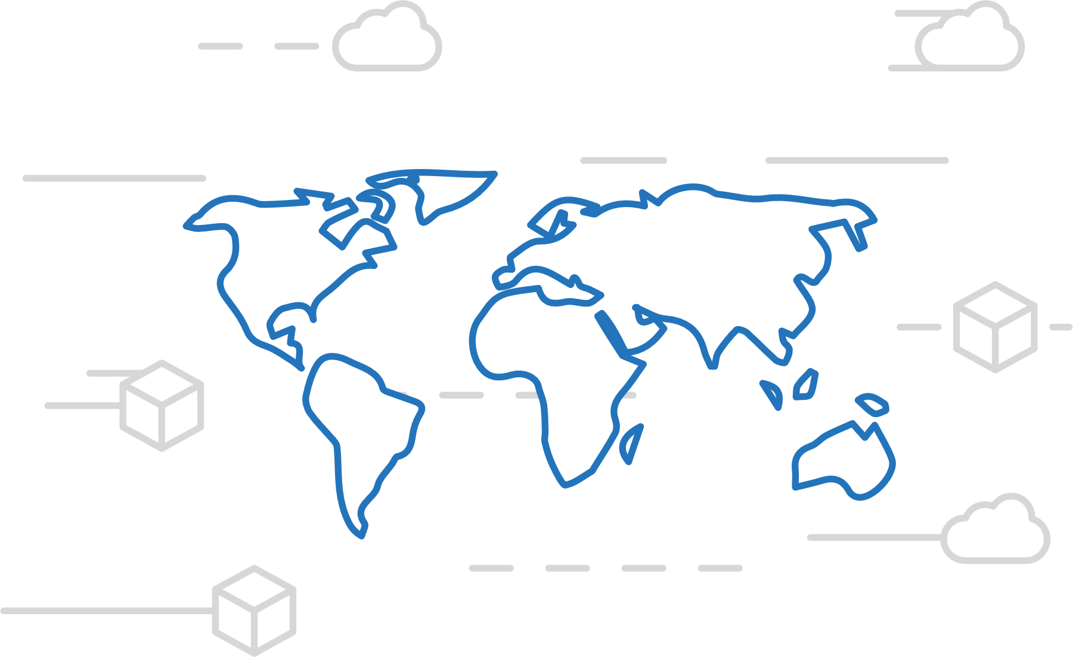
Azure Container Registry
Azure Kubernetes Service (AKS)
Manage a Docker private registry as a first-class Azure resource
Azure Container Instances (ACI)
Azure Container Registry
Open Service Broker API (OSBA)
Manage images for all types of containers
Use familiar, open-source Docker CLI tools
Azure Container Registry geo-replication
Release Automation Tools

Slide 102
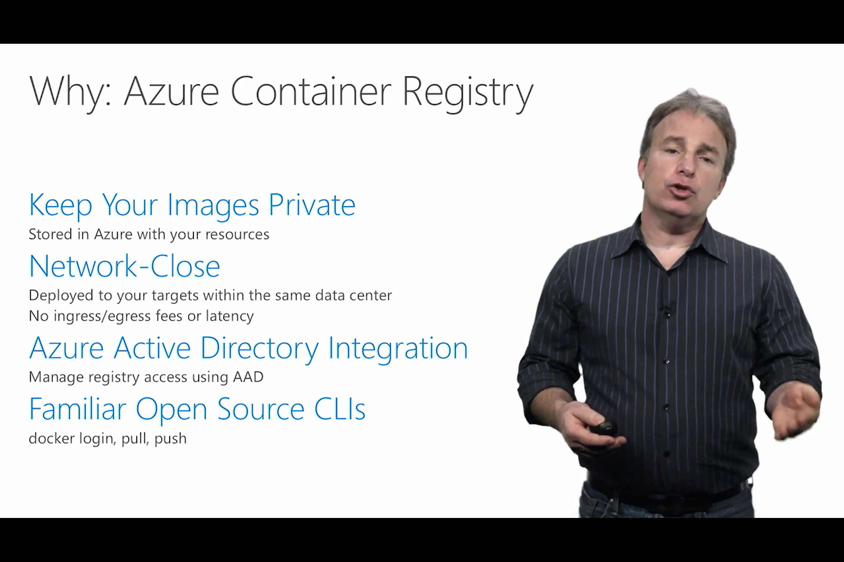
Azure Container Registry
Azure Kubernetes Service (AKS)
Resources
Azure Container Instances (ACI)
Azure Container Registry webpage
Registry technical documentation
Registry pricing details
Registry roadmap
Creating, configuring the Azure Container Registry
Azure Container Registry
Open Service Broker API (OSBA)
Release Automation Tools

Slide 103
Monitoring

Slide 104

Current monitoring is static in nature

Slide 105
Need to monitor for dynamic environments
Pod
Pod
Pod
Pod
Pod
Pod
Pod
Pod
Pod
Pod
Pod
Pod
Pod
Pod
Pod
Pod

Slide 106
Application Health and Readiness
Kubelets on workers use liveness and readiness probes to know when to restart a container or start directing traffic
Liveness check: when to restart
Readiness check: when to forward Service traffic to a pod
Notes:
Look at liveness
Look at readiness

Slide 107
Monitoring: What indicators matter in Kubernetes
Cluster health: total number of nodes, pods, etc
Node health: available compute resources, health
Application health
Tooling Examples
Datadog
Prometheus
InfluxData
Cloud-specific: OMS (Azure), CloudWatch (AWS)
Notes:
https://docs.datadoghq.com/integrations/kubernetes/

Slide 108
Logging
Pod logs: applications must log to standard out!
Cluster-wide event logs
Logging forwarder solutions
fluentd
logstash
Log indexers
OMS Log Analytics
Splunk
ELK stack

Slide 109
Scaling Applications

Slide 110
Application Scaling Strategies
Infrastructure Level
Increase/decrease the number of VM’s running in the cluster
Azure infrastructure function
via AKS API/CLI (utilizes Azure Availability Sets)
Auto-scaling coming to AKS soon
Application Level
Increase/decrease the number of pods for a given service
Handled by the orchestrator or the application itself
Kubernetes Horizontal Pod Autoscaling
These functions should be coordinated

Slide 111
Scaling Pods
Pod
Pod
Pod
Pod
Pod
Pod

Slide 112
Scaling Host
Pod
Pod
Pod
Pod
Pod
Pod
Pod
Pod

Slide 113
Scaling the ACS Cluster

Slide 114
Demo
Scale existing Deployment

Slide 115
Labs: 6, 7 https://github.com/OSSCanada/aks_partnerworkshop

Slide 116
Managing Storage and State

Slide 117
Managing State For Containers
Azure
Data Service
Local Storage
Remote Storage
Pod
Pod
Pod
CosmosDB

Slide 118

Open Service Broker for Azure
Azure Container Registry
Open source community
Azure Kubernetes Service (AKS)
Release automation tools
Containers 101
Getting started
Azure container technology
Open Service Broker for Azure (OSBA)
Customer success stories
Container orchestration
Azure Container Instances (ACI)

Slide 119

Open Service Broker for Azure (OSBA)
Azure Kubernetes Service (AKS)
Azure Container Instances (ACI)
OSBA
App Service
Azure Container Registry (ACR)
Partner services
Azure services
PaaS
Azure Container Registry
OpenShift
SQL Database
Azure Kubernetes Service (AKS)
Service Fabric
Batch
Pivotal Cloud Foundry
Redis Cache
ACS Engine
Open Service Broker API (OSBA)
Docker Enterprise Edition
CosmosDB
Virtual kubelet
Mesosphere DC/OS
And more!
Azure Container Instances (ACI)
Azure Virtual Machines
Virtual Machine Scale Sets (VMSS)
Release Automation Tools
Azure
IaaS

Slide 120
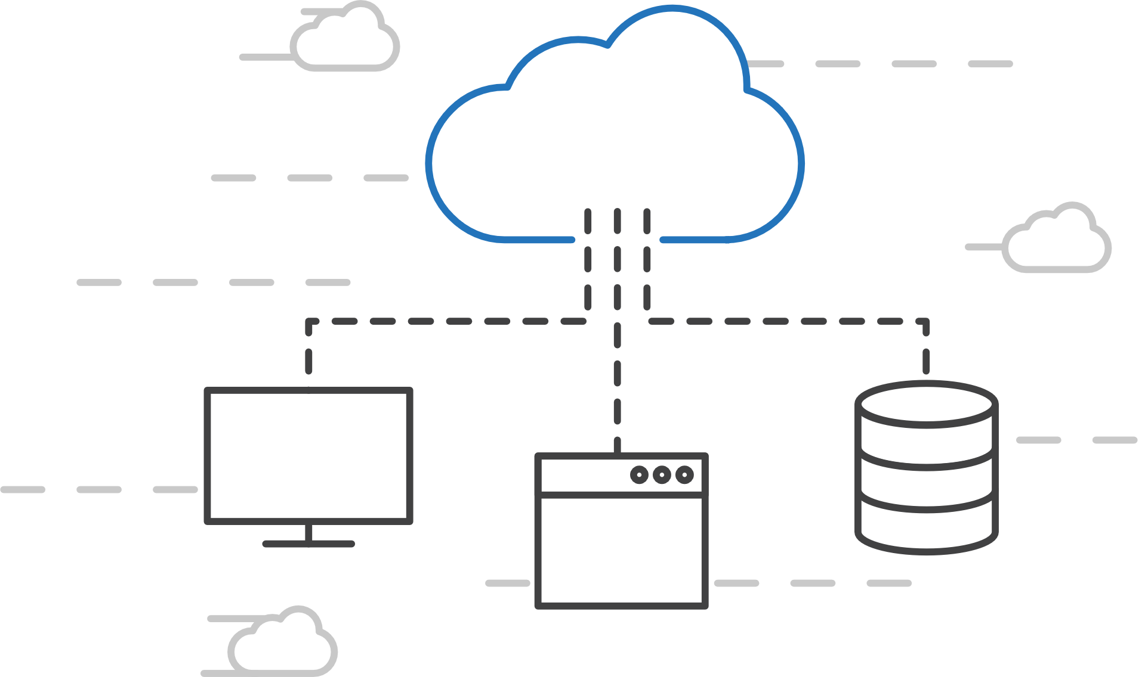
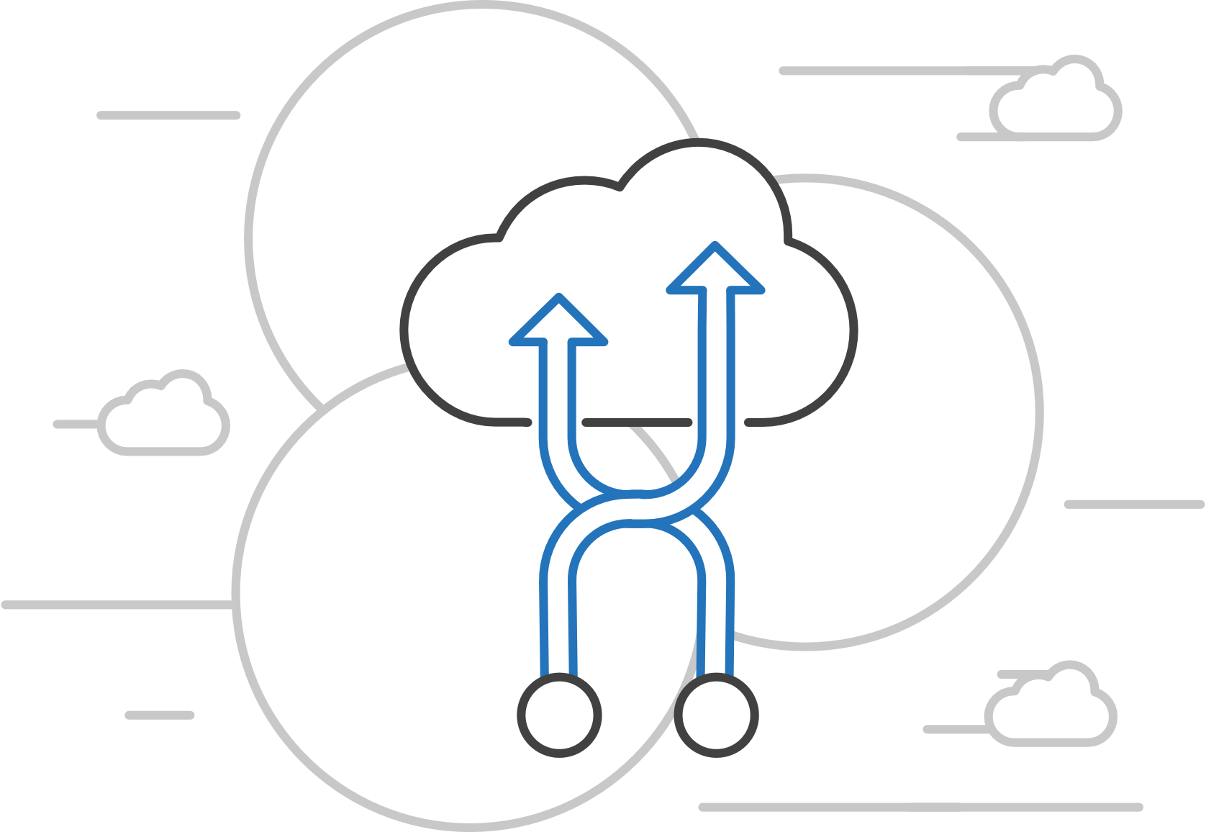
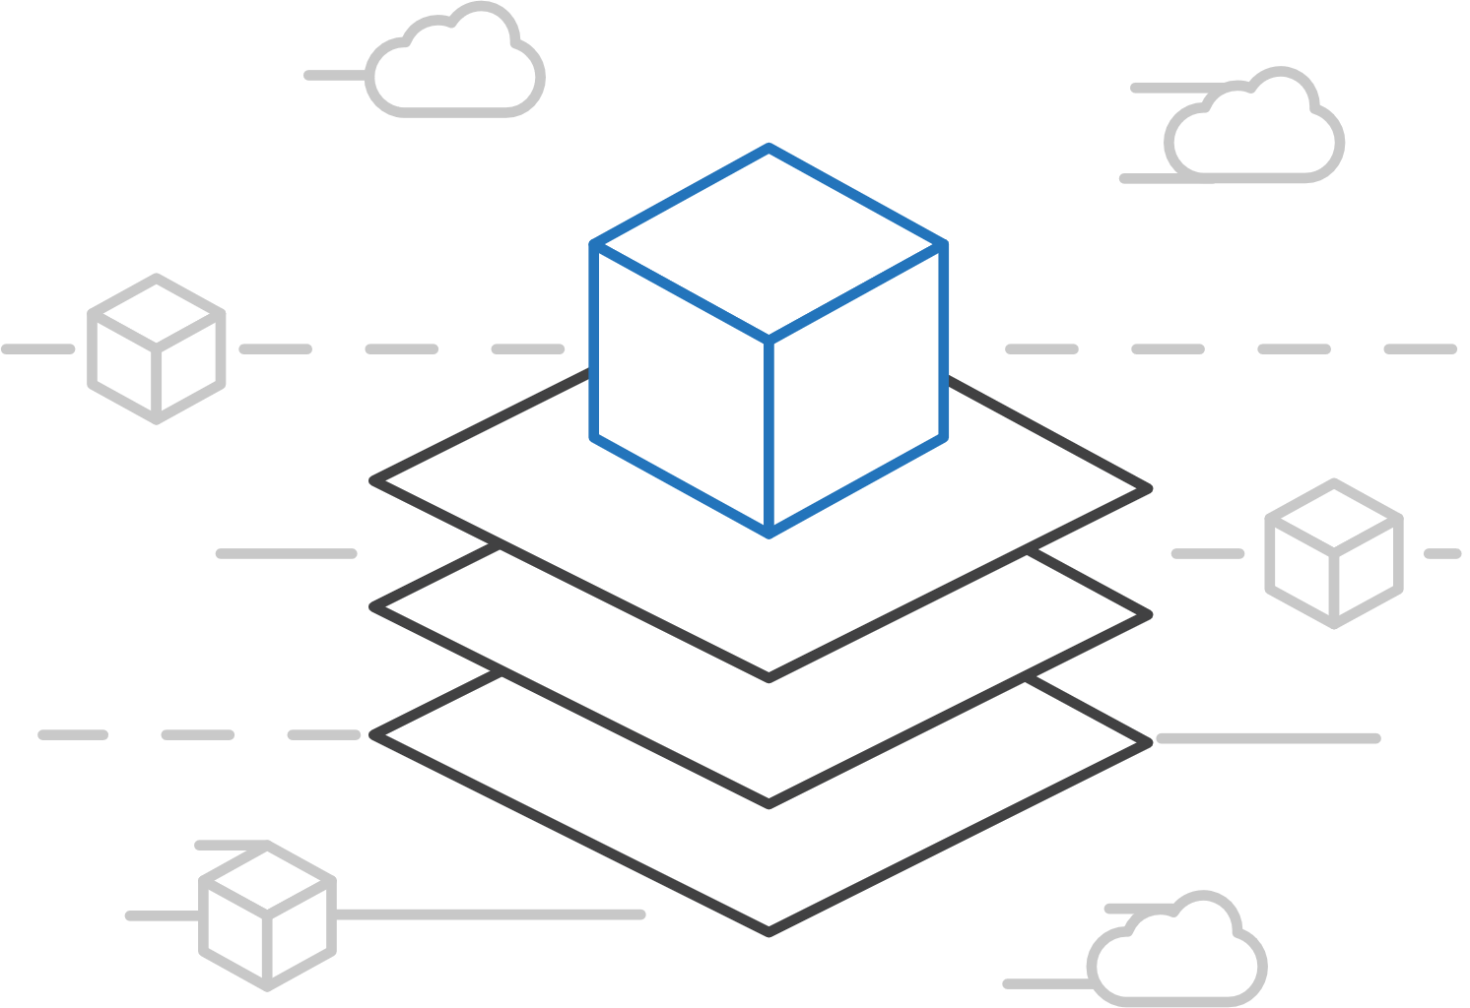
Open Service Broker for Azure (OSBA)
Azure Kubernetes Service (AKS)
Connecting containers to Azure services and platforms
Azure Container Instances (ACI)
Azure Container Registry
Open Service Broker API (OSBA)
A standardized way to connect with Azure services
Simple and flexible service integration
Compatible across numerous platforms
Release Automation Tools

Slide 121
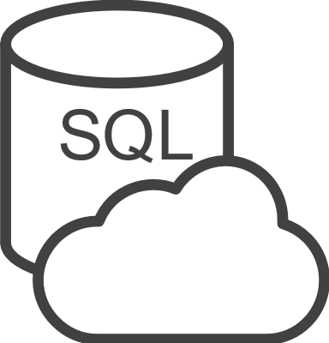




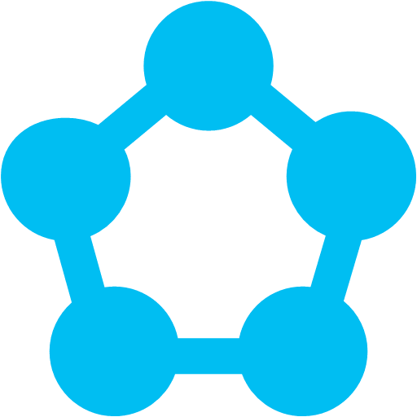
Open Service Broker for Azure (OSBA)
Azure Kubernetes Service (AKS)
An implementation of the Open Service Broker API
Azure Container Instances (ACI)
Azure SQL Database
Redis Cache
CosmosDB
And more!
Azure Container Registry
Open Service Broker for Azure (OSBA)
Open Service Broker API (OSBA)
Release Automation Tools
OpenShift
Cloud Foundry
Service Fabric (Coming soon)
Kubernetes (AKS)

Slide 122
Open Service Broker for Azure (OSBA)
Azure Kubernetes Service (AKS)
Getting started with ease
Azure Container Instances (ACI)
$ helm repo add azure Azure/helm-charts
$ helm install azure/service-broker
$ helm install azure/wordpress
Azure Container Registry
Open Service Broker API (OSBA)
Release Automation Tools

Slide 123
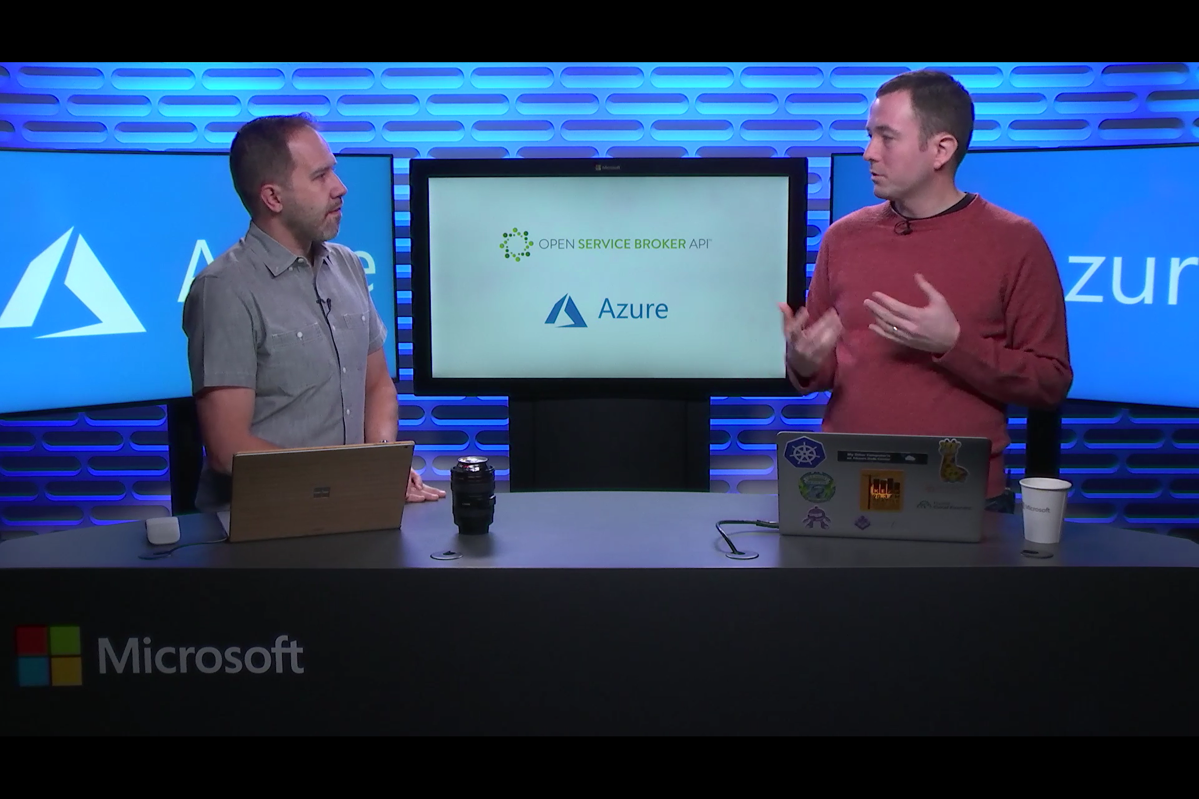
Open Service Broker for Azure (OSBA)
Azure Kubernetes Service (AKS)
Resources
Azure Container Instances (ACI)
Open Service Broker for Azure
OSBA announcement blog
OSBA on GitHub
Integrating with Azure-managed services using OSBA
Azure Container Registry
Open Service Broker API (OSBA)
Release Automation Tools

Slide 124
Upgrading Kubernetes in AKS

Slide 125
Demo
Container Persistence with Azure Disk
Version Upgrade Options

Slide 126
Labs: 8, 9, 10 https://github.com/OSSCanada/aks_partnerworkshop

Slide 127
Release automation tools
Azure Container Registry
Open source community
Azure Kubernetes Service (AKS)
Release automation tools
Containers 101
Getting started
Azure container technology
Open Service Broker for Azure (OSBA)
Customer success stories
Container orchestration
Azure Container Instances (ACI)

Slide 128




Release automation tools
Azure Kubernetes Service (AKS)
Simplifying the Kubernetes experience
Azure Container Instances (ACI)
Azure Container Registry
Open Service Broker API (OSBA)
Streamlined Kubernetes development
The package manager for Kubernetes
Event-driven scripting for Kubernetes
Visualization dashboard for Brigade
Release Automation Tools

Slide 129
Release automation workflow
Azure Kubernetes Service (AKS)
New code directory
Create a code file
Draft creates a dockerfile and a Helm chart for service composition
Azure Container Instances (ACI)
New directory
Add a code file
Draft create
Azure Container Registry
Yes
Does it work?
Git push
Draft commit
Draft up
Open Service Broker API (OSBA)
No
Deploy code container chart
CI/CD
Release Automation Tools
Draft helps devs get running
Draft helps devs and operations iterate on containers and services
Artifacts push to cloud, controlled by CI/CD processes

Slide 130
Release automation workflow
Azure Kubernetes Service (AKS)
Once developers are up and running—or working on a service that is in a complex system—Draft ALSO helps devs ignore artifacts and focus on code
Azure Container Instances (ACI)
Get clone
Draft pack-reps
Draft create
Azure Container Registry
Yes
Does it work?
Git push
Draft up
Open Service Broker API (OSBA)
No
Debug
CI/CD
Release Automation Tools
Draft helps devs get running
Draft helps devs and operations iterate on containers and services
Artifacts push to cloud, controlled by CI/CD processes

Slide 131
Release automation workflow
Azure Kubernetes Service (AKS)
Create
Azure Container Instances (ACI)
Draft create
Have code?
No
New
Draft page
Azure Container Registry
Yes
Builds image/config. to be deployed
Staged?
Yes
Code
Container
Configuration
Draft create or Draft create-pack (if specific artifacts exist)
Deploy image (AKS)
Deploy to staging
No
Open Service Broker API (OSBA)
Push image
Canary deploy to production
CD: No staging
No
Testing good?
Move to dev cluster
Change
Code
Container
Configuration
Actual development, Draft up/connect iteration
The building process: Brigade, Jenkins, VS TS
Build container
Telemetry successful?
Rollback
Yes
No
2 factor authentication
Push to production as canary
Release Automation Tools
Yes
Git push
Pull code
Rollout
Code/artifacts ready

Slide 132

Draft
Azure Kubernetes Service (AKS)
Simple app development and deployment – into any Kubernetes cluster
Azure Container Instances (ACI)
Azure Container Registry
Open Service Broker API (OSBA)
Simplified development
Using two simple commands, developers can now begin hacking on container-based applications without requiring Docker or even installing Kubernetes themselves
Language support
Draft detects which language your app is written in, and then uses packs to generate a Dockerfile and Helm Chart with the best practices for that language
Release Automation Tools

Slide 133
Helm
Azure Kubernetes Service (AKS)
The best way to find, share, and use software built for Kubernetes
Azure Container Instances (ACI)
Azure Container Registry
Manage complexity
Charts can describe complex apps; provide repeatable app installs, and serve as a single point of authority
Easy updates
Take the pain out of updates with in-place upgrades and custom hooks
Simple sharing
Charts are easy to version, share, and host on public or private servers
Rollbacks
Use helm rollout to roll back to an older version of a release with ease
Open Service Broker API (OSBA)
Release Automation Tools

Slide 134

Helm
Azure Kubernetes Service (AKS)
Helm Charts helps you define, install, and upgrade even the most complex Kubernetes application
Azure Container Instances (ACI)
services
ci
db
Azure Container Registry
load balancer
custom
…
Chart.yml
Open Service Broker API (OSBA)
Release Automation Tools

Slide 135
Helm Charts
Application definition
Consists of:
Metadata
Kubernetes resource definitions
Configuration
Documentation
Stored in chart repository
Any HTTP server that can house YAML/tar files (Azure, GitHub pages, etc.)
Public repo with community supported charts (eg – Jenkins, Mongo, etc.)
Helm (CLI) + Tiller (sever side)
Release: Instance of chart + values -> Kubernetes

Slide 136

Chart structure
Layout
Helm expects a strict chart structure

Slide 137
Helm values.yaml
The knobs and dials:
A values.yaml file provided with the chart that contains default values
Use -f to provide your own values overrides
Use --set to override individual values

Slide 138
Brigade
Azure Kubernetes Service (AKS)
Run scriptable, automated tasks in the cloud — as part of your Kubernetes cluster
Azure Container Instances (ACI)
Azure Container Registry
Open Service Broker API (OSBA)
Simple, powerful pipes
Each project gets a brigade.js config file, which is where you can write dynamic, interwoven pipelines and tasks for your Kubernetes cluster
Runs inside your cluster
By running Brigade as a service inside your Kubernetes cluster, you can harness the power of millions of available Docker images
Release Automation Tools

Slide 139

Brigade
Azure Kubernetes Service (AKS)
Brigade in action
Azure Container Instances (ACI)
Azure Container Registry
Open Service Broker API (OSBA)
Release Automation Tools

Slide 140
Kashti
Azure Kubernetes Service (AKS)
A simple UI to display build results and logs
Azure Container Instances (ACI)
Azure Container Registry
Simple visualizations
A web dashboard for Brigade, helping to easily visualize and inspect your Brigade builds
Driving deep insights
Make Brigade DevOps workflows— projects, scripts, and jobs—and their events visible instantly
Open Service Broker API (OSBA)
Release Automation Tools

Slide 141


Kashti
Azure Kubernetes Service (AKS)
Dashboards for Brigade pipelines
Azure Container Instances (ACI)
Azure Container Registry
Open Service Broker API (OSBA)
Release Automation Tools
Builds dashboard
Events log

Slide 142

Release automation tools
Azure Kubernetes Service (AKS)
Resources
Azure Container Instances (ACI)
Brigade Demo with Kashti dashboard
Draft webpage
Helm webpage
Brigade webpage
Kashti announcement blog
Azure Container Registry
Open Service Broker API (OSBA)
Release Automation Tools

Slide 143
Demo
Install via Helm
Development using Draft

Slide 144

Open source community
Azure Container Registry
(ACR)
Open source community
Azure Kubernetes Service (AKS)
Release automation tools
Containers 101
Getting started
Azure container technology
Open Service Broker for Azure (OSBA)
Customer success stories
Container orchestration
Azure Container Instances (ACI)

Slide 145

Community culture
Open source container code contributions
Numerous open source project builds
Open source community leadership

Slide 146










Open Source @ Microsoft
Ross Gardler
Apache Foundation
Principal Program Manager
Jessie Frazelle
Docker / Linux
Principal Cloud Developer Advocate
Brendan Burns
Kubernetes
Distinguished Engineer
Gabe Monroy
Deis / CNCF
Principal Program Manager
Notes:
Ross Gardler: https://www.geektime.com/2016/11/24/ross-gardler-apache-president-and-microsoft-manager-talks-the-future-of-open-source/
Jessie Frazelle: https://redmonk.com/jgovernor/2017/09/06/on-hiring-jessie-frazelle-microsofts-developer-advocacy-hot-streak-continues/
Brendan Burns: https://www.onmsft.com/news/google-engineer-kubernetes-founder-brendan-burns-joining-microsoft-azure
Gabe Monroy: http://www.businessinsider.com/microsoft-gabe-monroy-deis-docker-kubernetes-2017-5

Slide 147
Customer success stories
Azure Container Registry
(ACR)
Open source community
Azure Kubernetes Service (AKS)
Release automation tools
Containers 101
Getting started
Azure container technology
Open Service Broker for Azure (OSBA)
Customer success stories
Container orchestration
Azure Container Instances (ACI)

Slide 148



Rapidly growing software company attracts customers with seamless cloud demo experience
Headquartered in Freiburg, Germany, Jedox develops enterprise performance management software for businesses around the globe. Jedox chose Microsoft Azure to help it scale and grow. The company needed a more lightweight compute unit than virtual machines to power its website demos and provide a good customer experience. Jedox deployed Azure Container Instances to spin up customer demos on demand, improve provisioning speed, build confidence in the cloud, and lower IT costs.
Microsoft Azure
Microsoft Azure Container Instances
170 employees
Professional Services
Germany
Notes:
https://customers.microsoft.com/en-us/story/jedox-professional-services-azure
Jedox deployed Azure Container Instances to spin up customer demos on demand, improve provisioning speed, build confidence in the cloud, and lower IT costs.

Slide 149


Altair Engineering democratizes HPC access using the cloud
Altair Engineering makes computer-aided engineering software used to create stronger, better, more innovative products, from bicycles to space shuttles. To make its HyperWorks and Inspire applications available to more engineers, Altair delivers them through its Unlimited platform running in Microsoft Azure. In Azure, these solutions have access to affordable high-performance computing (HPC) resources, which enables low-cost collaboration among large engineering teams and opens up new markets for Altair.
Microsoft Azure
Microsoft Azure Container Service
Microsoft Azure Virtual Machines
2,000 Employees
Manufacturing
United States
Notes:
https://customers.microsoft.com/en-us/story/altair-manufacturing-azure
Inspire Unlimited also uses Kubernetes in Azure Container Service to handle back-end functions such as the web portal used by engineers to collaborate on models and a MongoDB database used to store document metadata. Kubernetes in Azure Container Service reduces operational management needs and allows Altair to increase the density of services running across compute nodes, taking better advantage of Azure capacity.

Slide 150


Energy company electrifies pace of innovation and expansion
Ambit Energy provides electricity and natural-gas services in deregulated markets around the world. It uses technology as a competitive differentiator, employing microservices, DevOps, and continuous deployment to speed software development. To stand up infrastructure just as quickly, Ambit uses Microsoft Azure services such as Azure Container Service, together with infrastructure as code and open source technologies, to completely automate infrastructure provisioning. By implementing Azure, Ambit can move dramatically faster to enhance its services and enter new markets. Infrastructure redundancy is flexible and worry-free. And costs are 22 percent lower, which helps Ambit compete in the crowded electricity market. Because Ambit’s cloud journey is gradual, it appreciates the fact that Azure is a great hybrid-cloud enabler, connecting easily to Ambit datacenters.
Products and services
Organization size
Industry
Country
Business need
Microsoft Azure Container Service
1,000 employees
Power and utilities
United States
Optimize operational efficiency
Notes:
https://customers.microsoft.com/en-us/story/ambit-energy

Slide 151


Siemens Health leverages technology to connect medical devices to the cloud through AKS
Digitization and networking between healthcare providers and software development companies are essential to value-based care. Moving from the development of value-added services into becoming more of a platform provider, it became important for Siemens to adopt a microservices approach to application delivery. To that end, Siemens adopted Azure Container Service (AKS) to run their microservices-based apps. AKS puts Siemens in a position not only to deploy business logic in Docker containers—including the orchestration—but also enables them to use an applicant gateway and API management to manage exposure, control, and to meter the access continuously. With their cloud-based development approach, Siemens has driven newfound product development agility. This project is already having a positive impact within the healthcare industry.
Products and services
Organization size
Industry
Country
Business need
Microsoft Azure Container Service
100,000+ employees
Healthcare
Germany
Faster application development

Slide 152
Getting started
Azure Container Registry
(ACR)
Open source community
Azure Kubernetes Service (AKS)
Release automation tools
Containers 101
Getting started
Azure container technology
Open Service Broker for Azure (OSBA)
Customer success stories
Container orchestration
Azure Container Instances (ACI)

Slide 153





Download free ebooks

Slide 154
Reminder about Day2 Tomorrow
Break into Partner Teams & Bring Your Own App
Web/API + Database
Challenge-Based
Challenge-based with Proctor Sign-off
No Step-by-Step, but Proctor Support
Here to help you with your App

Slide 155

Questions?

